Slide 1
Understanding the Linux operating system

Slide 2
register
poll
CPU
CPU
IO Port:
65535
一片连续端口
临界区
DMA:
Interrupt
Controller
Video Card
North
Bridge
RAM
South
Bridge
N路关联
Write through: 通写
Write Back: 回写
程序：局部性
空间局部性、时间局部性
置换策略

Slide 3
Cpu: 10G

Slide 4
73:74
指令计数器

Slide 6
4k, page, page frame(页框)

Slide 7
60-70%
仿真
Ready
Sleeping
可打断
不可打断

Slide 8
Monitor
  OS → VM

Slide 9
Write back(回写)
计算机的体系
  运算器
  控制器
  存储设备
  输入设备
  输出设备
TLB
CPU
Write through: 通写
MMU
NB
Memory
SB
I/O ports

Slide 10
Cache line
一级缓存
  指令缓存
  数据缓存

Slide 11
完全关联
  Full associative
部分关联
  Set associative
直接映射
  Direct mapping

Slide 12
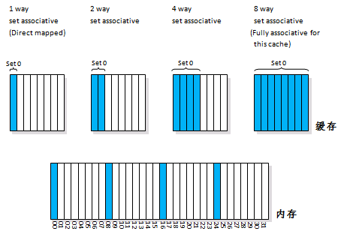

Slide 13
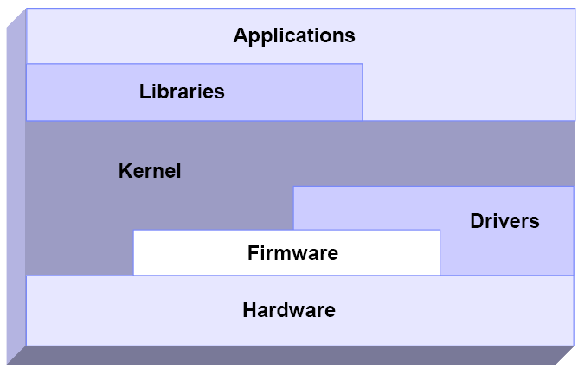
Schematic interaction of different performance components

Slide 14
Linux process management

Slide 15
What is a process?
A process is an instance of execution that runs on a processor
From the kernel's point of view, the purpose of a process is to act as an entity to which system resources (CPU time, memory, etc.) are allocated
  They include a set of resources such as open files and pending signals, internal kernel data, processor state, a memory address space with one or more memory mappings, one or more threads of execution, and a data section containing global variables

Slide 16
Process Descriptor and the Task Structure
To manage processes, the kernel must have a clear picture of what each process is doing
The kernel stores the list of processes in a circular doubly linked list called the task list
All processes running on Linux operating system are managed by the task_struct structure, which is also called a process descriptor
  The task_struct is a relatively large data structure, at around 1.7 kilobytes on a 32-bit machine

Slide 17
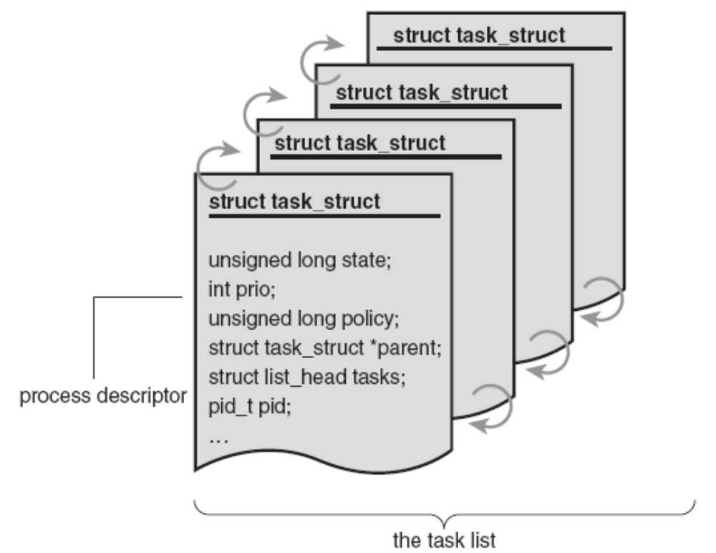
The process descriptor and task list
List
  Task_structure

Slide 18
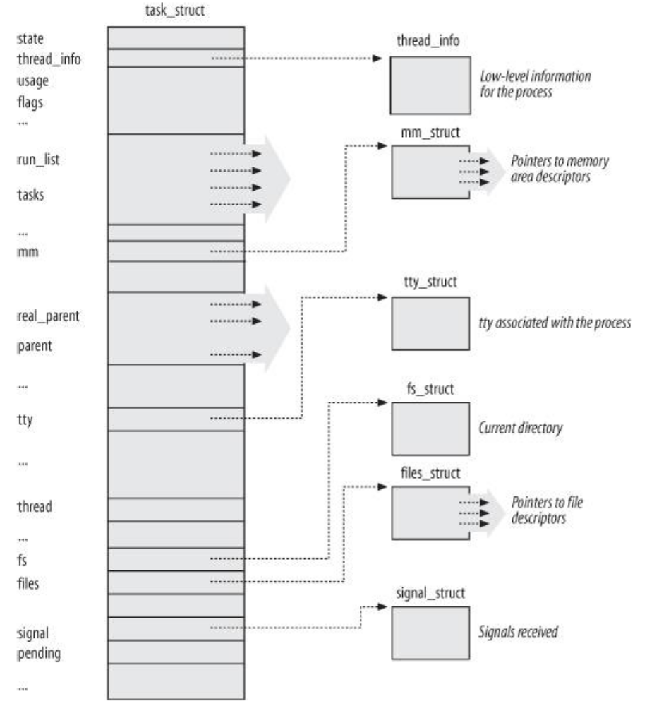
The Linux process descriptor

Slide 19
Process State
TASK_RUNNING
  The process is either executing on a CPU or waiting to be executed
TASK_INTERRUPTIBLE
  The process is suspended (sleeping) until some condition becomes true. Raising a hardware interrupt, releasing a system resource the process is waiting for, or delivering a signal are examples of conditions that might wake up the process (put its state back to TASK_RUNNING)
  A typical example of a TASK_INTERRUPTIBLE process is a process waiting for keyboard interrupt

Slide 20
TASK_UNINTERRUPTIBLE
  Like TASK_INTERRUPTIBLE, except that delivering a signal to the sleeping process leaves its state unchanged
  A typical example of a TASK_UNINTERRUPTIBLE process is a process waiting for disk I/O operation
TASK_STOPPED
  Process execution has been stopped; the process enters this state after receiving a SIGSTOP, SIGTSTP, SIGTTIN, or SIGTTOU signal

Slide 21
TASK_TRACED
  Process execution has been stopped by a debugger
  When a process is being monitored by another (such as when a debugger executes a ptrace( ) system call to monitor a test program), each signal may put the process in the TASK_TRACED state
TASK_ZOMBIE
  Process execution is terminated, but the parent process has not yet issued a wait4( ) or waitpid( ) system call to return information about the dead process

Slide 22
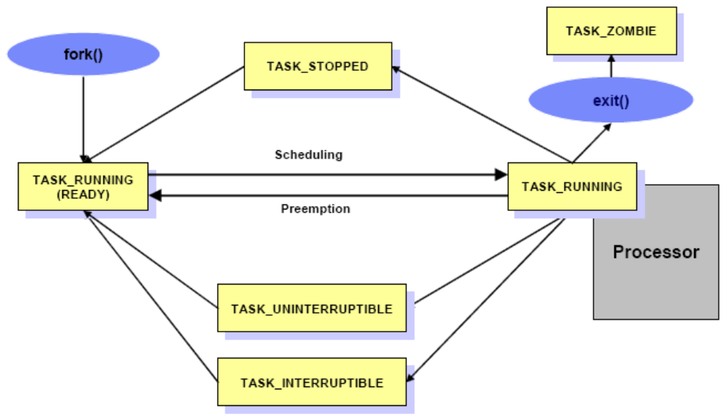
Process State

Slide 23
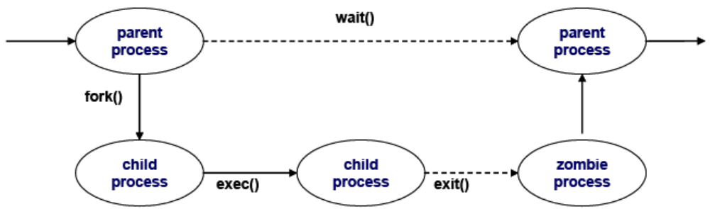
Life cycle of a process
Every process has its own life cycle such as creation, execution, termination, and removal

Slide 24
When a process creates a new process, the creating process (parent process) issues a fork() system call
  When a fork() system call is issued, it gets a process descriptor for the newly created process (child process) and sets a new process id
  It copies the values of the parent process’ process descriptor to the child’schild’s. At this time the entire address space of the parent process is not copied; both processes share the same address space

Slide 25
The exec() system call copies the new program to the address space of the child process
  Because both processes share the same address space, writing new program data causes a page fault exception
  At this point, the kernel assigns the new physical page to the child process
  This deferred operation is called the Copy On Write

Slide 26
When program execution has completed, the child process terminates with an exit() system call
  The exit() system call releases most of the data structure of the process and notifies the parent process of the termination sending a signal
  At this time, the process is called a zombie process

Slide 27
The child process will not be completely removed until the parent process knows of the termination of its child process by the wait() system call
As soon as the parent process is notified of the child process termination, it removes all the data structure of the child process and release the process descriptor

Slide 28
Thread
A thread is an execution unit generated in a single process
  It runs parallel with other threads in the same process
  They can share the same resources such as memory, address space, open files, and so on
  They can access the same set of application data
  A thread is also called Light Weight Process (LWP)
  Because they share resources, each thread should not change their shared resources at the same time
    The implementation of mutual exclusion, locking, serialization, and so on, are the user application’s responsibility

Slide 29
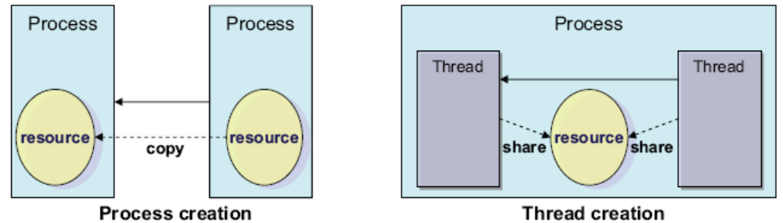
From the performance perspective, thread creation is less expensive than process creation because a thread does not need to copy resources on creation

Slide 30
In current Linux implementations, a thread is supported with the Portable Operating System Interface for UNIX (POSIX) compliant library (pthread)
Several thread implementations are available in the Linux operating system:
  Linux Threads
  Native POSIX Thread Library (NPTL)
  Next Generation POSIX Thread (NGPT)
Using the LD_ASSUME_KERNEL environment variable, you can choose which threads library the application should use

Slide 31
Context switching
To control the execution of processes, the kernel must be able to suspend the execution of the process running on the CPU and resume the execution of some other process previously suspended
  This activity goes variously by the names process switch, task switch, or context switch
While each process can have its own address space, all processes have to share the CPU registers
  So before resuming the execution of a process, the kernel must ensure that each such register is loaded with the value it had when the process was suspended
The process descriptor and the area called kernel mode stack are used to store the context

Slide 32
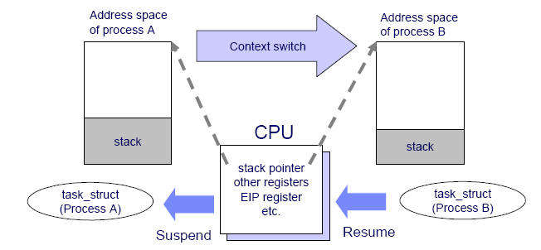
Context switching

Slide 33
O(1)
SCHED_Other
CFS: Complete Fair Scheduler

Slide 34
Process memory segments
A process uses its own memory area to perform work
The work varies depending on the situation and process usage
  A process can have different workload characteristics and different data size requirements
  The process has to handle a of variety of data sizes
To satisfy this requirement, the Linux kernel uses a dynamic memory allocation mechanism for each process

Slide 35
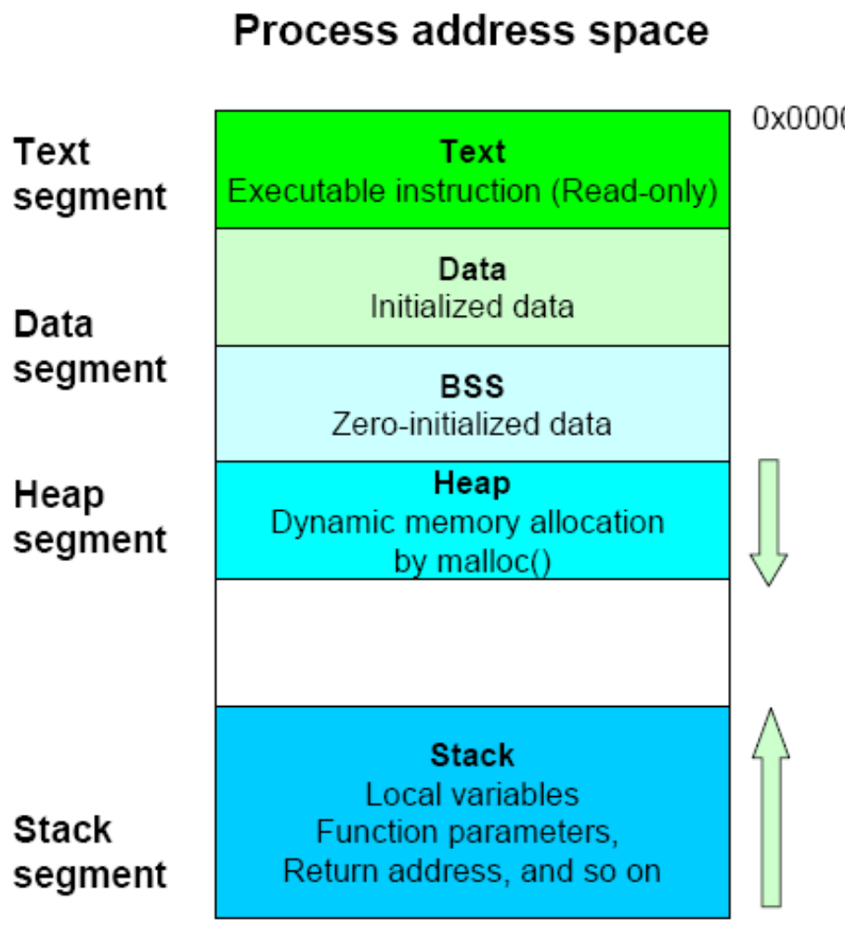
Process address space

Slide 36
Init, fork()
Process
  Kernel
    COW: 写时复制
      Copy On Writing

Slide 37
Nginx:worker
SMP

Slide 38
COW
  Kernel → init
    init
      fork(): 系统调用
      task_struct
        Memory → Parent
        COW: Copy On Write

Slide 39
多任务
  自愿式多任务
  抢占式多任务
上下文切换(Context Switch)

Slide 40
Big O
  O(1)
  O(logn)
  O(n)
  O(n^2)
  O(2^n)

Slide 41
动态
静态
实时优先级 0-99
0-139
100-139
  120 （-20 至 19）
进程的类型
  交互式进程
  批处理进程
  实时进程
交互式进程
  I/O Bound
批处理进程
  CPU Bound

Slide 42
Classes of processes
Interactive processes
  These interact constantly with their users, and therefore spend a lot of time waiting for keypresses and mouse operations
Batch processes
  These do not need user interaction, and hence they often run in the background
Real-time processes
  These have very strong scheduling requirements
  Such processes should never be blocked by lower-priority processes, they should have a short response time and, most important, such response time should have a minimum variance
  Typical real-time programs are video and sound applications, robot controllers, and programs that collect data from physical sensors

Slide 43
Process Scheduling
Multitasking
  Multitasking operating systems come in two flavors: cooperative multitasking and preemptive multitasking
  Linux, like all Unix variants and most modern operating systems, implements preemptive multitasking
  In preemptive multitasking, the scheduler, one of the kernel subsystem, decides when a process is to cease running and a new process is to begin running
    The act of involuntarily suspending a running process is called preemption

Slide 44
Linux’s Process Scheduler
O(1) scheduler
  It scales well with the number of runnable processes, because it selects the process to run in constant time, independently of the number of runnable processes
  It also scales well with the number of processors because each CPU has its own queue of runnable processes
  The new algorithm does a better job of distinguishing interactive processes and batch processes
  But, O(1) scheduler had several pathological failures related to scheduling latency-sensitive applications
    Thus, although the O(1) scheduler was ideal for large server workloads—which lack interactive processes—it performed below par on desktop systems, where interactive applications are the raison d’être

Slide 45
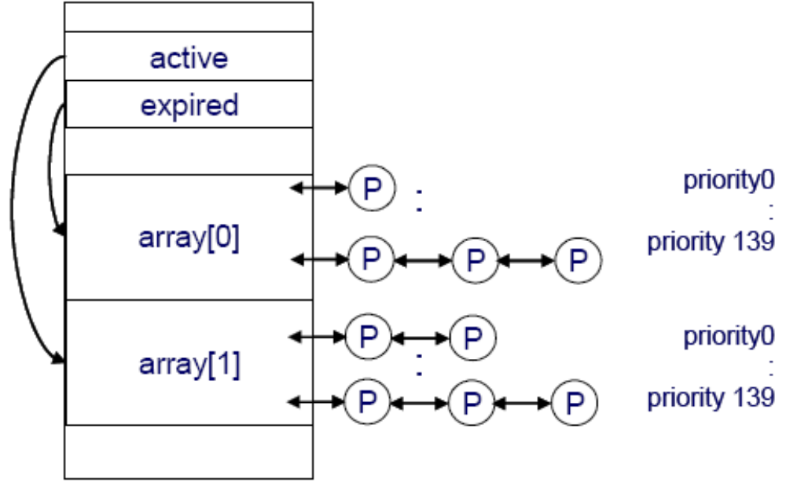
Linux kernel 2.6 O(1) scheduler

Slide 46
Linux scheduling is based on the time sharing technique
  Several processes run in "time multiplexing" because the CPU time is divided into slices, one for each runnable process
  Time sharing relies on timer interrupts and is thus transparent to processes
The scheduling policy is also based on ranking processes according to their priority

Slide 47
Process Preemption
If a process enters the TASK_RUNNING state, the kernel checks whether its dynamic priority is greater than the priority of the currently running process
  If it is, the execution of current is interrupted and the scheduler is invoked to select another process to run
  a process may also be preempted when its time quantum expires
    when this occurs, the need_resched field of the current process is set, so the scheduler is invoked when the timer interrupt handler terminates

Slide 48
Preempting the current process
Standard preemption rules
  CPU receives a hard interrupt
  Process requests IO
  Process voluntarily surrenders the CPU via sched_yield
  Scheduler algorithm determines that process should be preempted
Viewing scheduler policy and priority
  chrt -p pid
  ps axo pid,comm,rtprio,policy
  top
The init process starts with SCHED_OHTER
  Each process inherits parent’s scheduling policy and priority at creatation time

Slide 49
Scheduling Policy
Policy is the behavior of the scheduler that determines what runs when
  A scheduler’s policy often determines the overall feel of a system and is responsible for optimally utilizing processor time
The scheduling algorithm of traditional Unix operating systems must fulfill several conflicting objectives:
  fast process response time
  good throughput for background jobs
  avoidance of process starvation
  reconciliation of the needs of low
  high-priority processes
  and so on
The set of rules used to determine when and how to select a new process to run is called scheduling policy

Slide 50
Characterizing processes
When speaking about scheduling, processes are traditionally classified as I/O-bound or CPU-bound
  The former is characterized as a process that spends much of its time submitting and waiting on I/O requests
  Conversely, processor-bound processes spend much of their time executing code
    A scheduler policy for processor-bound processes tends to run such processes less frequently but for longer durations
Linux, aiming to provide good interactive response and desktop performance, optimizes for process response (low latency), thus favoring I/O-bound processes over processor-bound processors

Slide 51
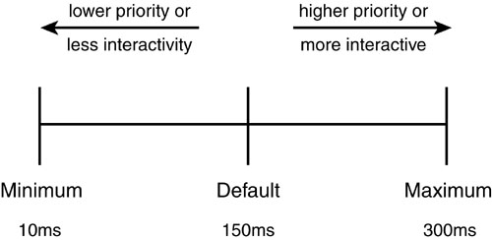
Process Priority
In Linux, process priority is dynamic
  The scheduler keeps track of what processes are doing and adjusts their priorities periodically
    Processes that have been denied the use of a CPU for a long time interval are boosted by dynamically increasing their priority
    Processes running for a long time are penalized by decreasing their priority

Slide 52
Static priority
Every conventional process has its own static priority, which is a value used by the scheduler to rate the process with respect to the other conventional processes in the system
The kernel represents the static priority of a conventional process with a number ranging from 100 (highest priority) to 139 (lowest priority)
New process always inherits the static priority of its parent
  However, a user can change the static priority of the processes that he owns by passing some "nice values"

Slide 53
real-time priority
0-99
  higher real-time priority values correspond to a greater priority
All real-time processes are at a higher priority than normal processes; that is, the real-time priority and nice value are in disjoint value spaces
  ps -eo state,uid,pid,ppid,rtprio,time,comm

Slide 54
Timeslice
The timeslice is the numeric value that represents how long a task can run until it is preempted
  The scheduler policy must dictate a default timeslice, which is not a trivial exercise

Slide 55
The Scheduling Algorithm
Scheduler Classes
  The Linux scheduler is modular, enabling different algorithms to schedule different types of processes
    This modularity is called scheduler classes
    Scheduler classes enable different, pluggable algorithms to coexist, scheduling their own types of processes
    Each scheduler class has a priority. The highest priority scheduler class that has a runnable process wins, selecting who runs next

Slide 56
Scheduling classes
Every Linux process is always scheduled according to one of the following scheduling classes :
  SCHED_FIFO [1-99]
    A First-In, First-Out real-time process
  SCHED_RR
    A Round Robin real-time process
  SCHED_NORMAL (100-139)
    A conventional, time-shared process
    Also named by SCHED_OTHER
    For normal processes

Slide 57
SCHED_OTHER
Priority may vary
  Processes with equal priority can preempt current process every 20ms to prevent CPU starvation
  CPU bound processes receive a +5 priority penalty after preemption
Interactive tasks spend time waiting for IO
  Scheduler tracks time spent waiting for IO for each process and calculates a sleep average
  High sleep average indicates interactive process
    Interactive processes may be re-inserted into the active queue
    If not, receive a -5 priority boost and move to expired queue

Slide 58
Tuning scheduler policy
SCHED_FIFO
  chrt -f [1-99] /path/to/program arguments
SCHED_RR
  chrt -r [1-99] /path/to/program arguments
SCHED_OTHER (SCHED_NORMAL)
  nice
  renice

Slide 59
调度类别：
  RT
    SCHED_FIFO
    SCHED_RR
  100-139
    SCHED_Other
  SCHED_BATCH
  SCHED_IDLE
抢占
  tick：时钟中断
    100Hz
    1000Hz
RHEL 6.4
  tick less
  interrupt-driven
    硬中断
    软中断
    深度睡眠

Slide 60
I1，D1
0
1
2
3

Slide 61
0
1

Slide 62
socket
SMP
  对称多处理器

Slide 63
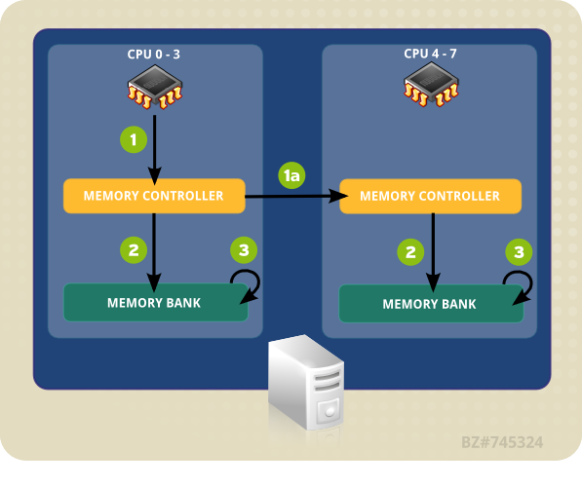
Local and Remote Memory Access in NUMA Topolog

Slide 65
Viewing CPU performance data
Load average: average length of run queues
  Considers only tasks in TASK_RUNNABLE and TASK_UNINTERRUPTABLE
    sar -q
    top
    w
    uptime
    vmstat 1 5
CPU utilization
    mpstat 1 2
    sar -P ALL 1 2
    iostat -c 1 2
    /proc/stat
    dstat -c

Slide 66
Hardware timers are used as clocks
  RTC
  TSC
  APIC
  PIC
  100Hz, 10ms
  tick， jiffy
  tick_divider=1

Slide 67
Equalizing CPU visit count
Process moves to the expired queue when preempted
  Imposes a built-in affinity for the CPU
  Can lead to unbalanced run queues
Scheduler rebalances run queues
  Every 100ms if all processors are busy
  Every 1ms if a CPU is idle
  View a specific process
    watch -n.5 ‘ps axo comm,pid,psr| grep program_name’
Consequences
  Lower visit count leads to higher throughput
  Moving a task to another CPU guarantees a cache miss

Slide 68
Tuning process affinity with taskset
Use the taskset command to pin a task to a CPU
  taskset [opts] [mask|list] [pid|command [arg]...]
  # taskset -c -p cpulist PID
  mask
    0x00000001 CPU #0
    0x00000002 CPU #1
    0x00000003 CPU #0 and CPU #1
Consequences
  Improve cache hits(lower service time) for applications with unit cache stride
  Unbalanced run queues can cause log wait times
  For NUMA, avoid non-local memory accesses

Slide 69
0-3
0,3
0x00000001: 0
0x00000011: 0,1

Slide 70
Tuning run queue length with taskset
Restrict length of a CPU run queue
  Isolate a CPU from automatic scheduling in /etc/grub.conf
    isolcpus=cpu number,…,cpu number
  Pin tasks to that CPU with taskset
  Consider moving IRQs off the CPU

Slide 71
echo cpu_mask > /proc/irq/<irq_num>/smp_affinity
0,1
2-15:

Slide 72
Scheduler domains
Group processors into cpusets
  Each cpuset represents a scheduler domain
  Supports both multi-core and NUMA architectures
  Simple management interface through the cpuset virtual file system
The root cpuset contains all system resources
Child cpusets
  Each cpuset must contain at least one CPU and one memory zone
  Child cpusets can be nested
  Dynamically attach tasks to a cpuset
Consequences
  Control latency due to queue length, cache, and NUMA zones
  Assign processes with different CPU characteristics to different cpusets
  Scalable for complex performance scenarios

Slide 73
Numa
0
1
3
2

Slide 74
Configuring the root cpuset
Create a mount point at /cpusets
Add an entry to /etc/fstab
  cpuset /cpusets cpuset defaults 0 0
Mount the filesystem to automatically create the cpuset
  /cpusets/cpus
  /cpusets/mems
  /cpusets/tasks
  All CPUs and memory zones belong to the root cpuset
  All existing PIDs are assigned to the root cpuset

Slide 75
Configuring a child cpuset
Create a subdirectory of the root cpuset
  mkdir /cpusets/magedu
Assign resources as a range or comma-separated list
  echo 0 > /cpusets/magedu/cpus
  echo 0 > /cpusets/magedu/mems
Attach one task at a time
  echo `pidof process` > /cpusets/magedu/tasks
Persist in /etc/rc.local

Slide 76
Linux memory architecture

Slide 77
OS
  调度子系统
  内存子系统

Slide 78
线性地址
物理地址

Slide 79
task_struct
code, (read-only)
Data
(环境变量)BSS
heap
stack

Slide 80
Memory Addresses
Logical address (segment)
  Included in the machine language instructions to specify the address of an operand or of an instruction
  This type of address embodies the well-known 80 x 86 segmented architecture
Linear address (also known as virtual address)
  A single 32-bit unsigned integer that can be used to address up to 4 GB that is, up to 4,294,967,296 memory cells
  Linear addresses are usually represented in hexadecimal notation; their values range from 0x00000000 to 0xffffffff
Physical address
  Used to address memory cells in memory chips

Slide 81
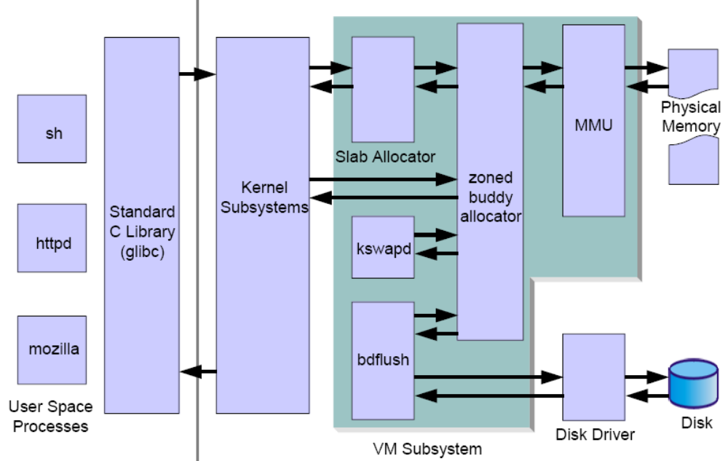
Virtual memory manager

Slide 82
dirty page
clean page

Slide 83
COW
TLB
MMU
1MB=1024K
4K，8G
2^16, 2^10
HugePage

Slide 84
Paging in Hardware
For the sake of efficiency, linear addresses are grouped in fixed-length intervals called pages
The paging unit translates linear addresses into physical ones
The paging unit thinks of all RAM as partitioned into fixed-length page frames
  Each page frame contains a page that is, the length of a page frame coincides with that of a page
  A page frame is a constituent of main memory, and hence it is a storage area
The data structures that map linear to physical addresses are called page tables
  They are stored in main memory and must be properly initialized by the kernel before enabling the paging unit

Slide 85
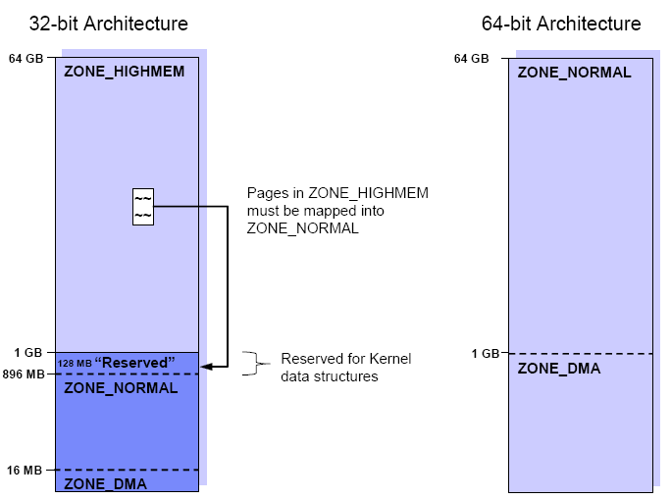
The Linux Memory Architecture
PAE:36bit

Slide 86
SRAM
  Static RAM
DRAM
DDR
  Dynamic RAM
  SDRAM
  DDR
  Rambus DRAM

Slide 87
Zones
Because of hardware limitations, the kernel cannot treat all pages as identical
  Some pages, because of their physical address in memory, cannot be used for certain tasks
  Because of this limitation, the kernel divides pages into different zones
  The kernel uses the zones to group pages of similar properties

Slide 88
ZONE_DMA
  This zone contains pages that can undergo DMA
ZONE_DMA32
  Like ZOME_DMA, this zone contains pages that can undergo DMA
  Unlike ZONE_DMA, these pages are accessible only by 32-bit devices
  On some architectures, this zone is a larger subset of memory
ZONE_NORMAL
  This zone contains normal, regularly mapped, pages
ZONE_HIGHMEM
  This zone contains “high memory,” which are pages not permanently mapped into the kernel’s address space

Slide 89
Virtual memory addressing layout
On 32-bit architectures, the maximum address space that single process can access is 4GB
  The Linux kernel can directly address only the first gigabyte of physical memory (896 MB when considering the reserved range)
In a standard implementation, the virtual address space is divided into a 3 GB user space and a 1 GB kernel space

Slide 90
Physical address space
Kernel uses page table entries to translate virtual addresses tinto physical pages
  PTEs are cached in translation lookaside buffers(TLB)
  Hardware TLB determines data and instruction page sizes
    x86info -c
    dmesg
Kernel memory is non-pageable(non-swappable)
Keeping track of in-use pages
  A page frame refers to a page of RAM
  The kernel uses page tables to keep track of page frames
  Each process has its own page table structures
  The page table maps virtual addresses to physical addresses

Slide 91
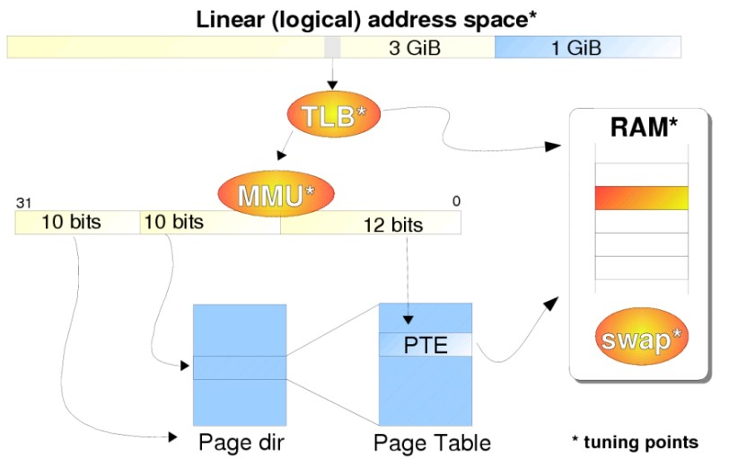
Mapping virtual addresses(x86)

Slide 94
缺页异常：
major
minor

Slide 95
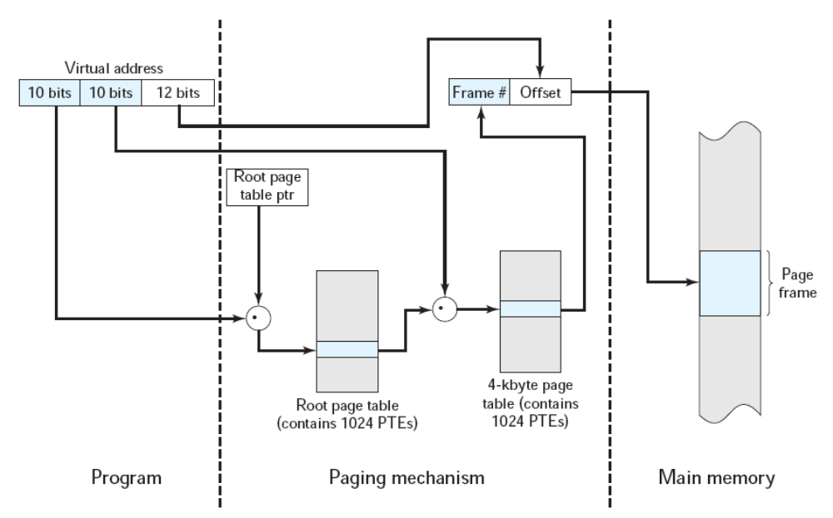
Address Translation

Slide 96
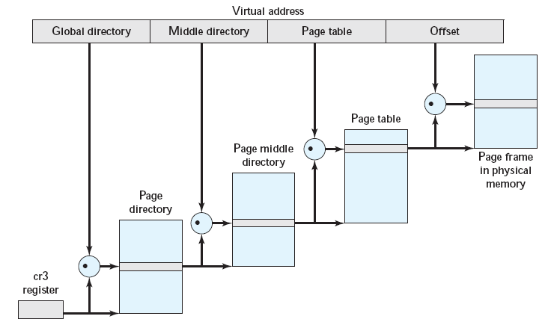
Address Translation in Linux Virtual Memory Scheme

Slide 97
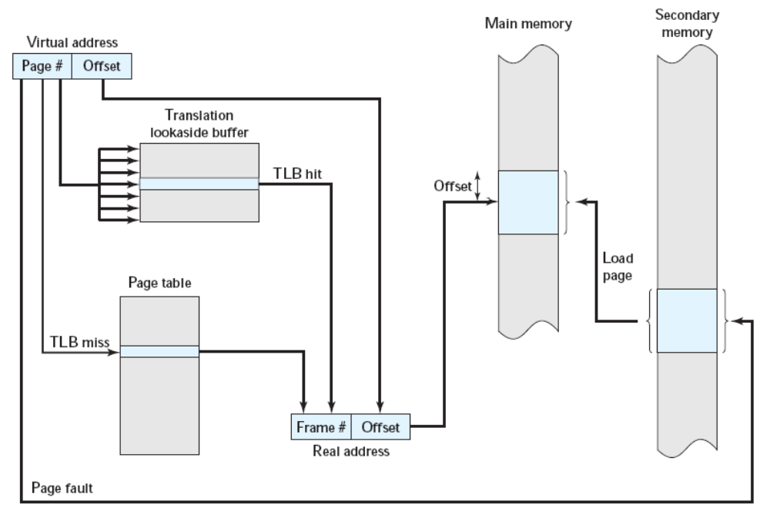
Use of a Translation Lookaside Buffer

Slide 98
/proc/zoneinfo

Slide 99
huge page

Slide 100
Viewing process address space
Proc files
  /proc/PID/status
  /proc/PID/statm
Commands
  gnome-system-monitor
  pmap
  memusage
    yum install glibc-utils
  dstat –m
  top

Slide 101
/proc/PID/statm
Provides information about memory status in pages
The columns are:
  size total program size
  resident resident set size
  share shared pages
  text text (code)
  lib library
  data data/stack
  dt dirty pages (unused in Linux 2.6)

Slide 102
Overview of memory allocation
Process forks or execs child process
  Child process uses parent process’s page frame until a write access is made
  This is referred to as copy on write
New process requests memory
  kernel commits additional virtual address space to process
New process uses memory
  Triggers a page fault exception
    Minor: Kernel allocates a new page frame with help form MMU
    Major: Kernel blocks process while page is retrieved from disk
Process frees memory
  Kernel reclaims pages
  ps axo minflt,majflt
  ps -o minflt,majflt PID

Slide 103
pi: page in
po: page out
si: Swap in
so: Swap out

Slide 104
/proc/sys/vm/min_free_kbytes

Slide 105
Page frame allocation
A page is usually 4 K bytes in size
When a process requests a certain amount of pages, if there are available pages the Linux kernel can allocate them to the process immediately
Otherwise pages have to be taken from some other process or page cache
The kernel knows how many memory pages are available and where they are located

Slide 106
Improving RAM performance
Static RAM (SRAM)
  Keeps data without updating
  more expensive
Dynamic RAM(DRAM)
  Must be refreshed
  Synchronous DRAM (SDRAM) is synchronized to CPU clock
  Double data rate DRAM (DDR) reads on both sides of clock signal
  Rambus DRAM (RDRAM) uses a high-speed, narrow bus architecture

Slide 107
Hugetable page
Hugetlbfs support is built on top of multiple page size support that is provided by most modern architectures
Users can use the huge page support in Linux kernel by either using the mmap system call or standard Sysv shared memory system calls (shmget, shmat)
  cat /proc/meminfo | grep HugePage

Slide 108
Improving TLB performance
Kernel must usually flush TLB entries upon a context switch
Use free, contiguous physical pages
  Automatically via the buddy allocator
  /proc/buddyinfo
  Manually via hugepages (not pageable)
    Linux supports large sized pages through the hugepages mechanism
    Sometimes known as bigpages, largepages or the hugetlbfs filesystem
Consequences
  TLB cache hit more likely
  Reduces PTE visit count

Slide 109
Tuning TLB performance
Check size of hugepages
  x86info -a | grep “Data TLB”
  dmesg
  cat /proc/meminfo
Enable hugepages
  In /etc/sysctl.conf
  vm.nr_hugepages = n
  Kernel parameter
  hugepages=n
Configure hugetlbfs if needed by application
  mmap system call requires that hugetlbfs is mounted
    mkdir /hugepages
    mount -t hugetlbfs none /hugepages
  shmat and shmget system calls do not require hugetlbfs

Slide 110
Viewing system calls
Trace every system call made by a program
  strace -o /tmp/strace.out -p PID
  grep mmap /tmp/strace.out
Summarize system calls
  strace -c -p PID or
  strace -c COMMAND
Other uses
  Investigate lock contentions
  Identify problems caused by improper file permissions
  Pinpoint IO problems

Slide 111
Strategies for using memory
Reduce overhead for tiny memory objects
  Slab cache
Reduce or defer service time for slower subsystems
  Filesystem metadata: buffer cache (slab cache)
  Disk IO: page cache
  Interprocess communications: shared memory
  Network IO: buffer cache, arp cache, connection tracking
Considerations when tuning memory
  How should pages be reclaimed to avoid pressure?
  Larger writes are usually more efficient due to re-sorting

Slide 112
A closer look at demand paging
Page frames are not allocated until the process has something to store
  Resident pages are located in RAM
  Non-resident pages are on disk or have not been used
Allows the kernel to overcommit memory system-wide
  Advantageous for scientific applications
  Usually works well due to locality of reference for executable images and memory
  Memory (RAM+swap) may not be available when the process hash something to store

Slide 113
Tuning page allocation
Set using
  vm.min_free_kbytes
    Tuning vm.min_free_kbytes only be necessary when an application regularly needs to allocate a large block of memory, then frees that same memory
    It may well be the case that the system has too little disk bandwidth, too little CPU power, or too little memory to handle its load
Consequences
  Reduces service time for demand paging
  Memory is not available for other useage
  Can cause pressure on ZONE_NORMAL

Slide 115
Tuning overcommit
Set using
  vm.overcommit_memory
    0 = heuristic overcommit
    1 = always overcommit
    2 = commit all RAM plus a percentage of swap (may be > 100)
  vm.overcommit_ratio
      Specified the percentage of physical memory allowed to be overcommited when the vm.overcommit_memory is set to 2
View Committed_AS in /proc/meminfo
  An estimate of how much RAM is required to avoid an out of memory (OOM) condition for the current workload on a system
Notes:
512M+1G*20%
, 768m

Slide 116
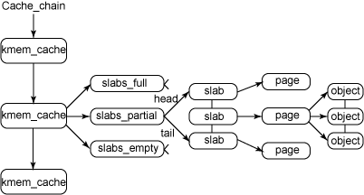
Slab
The slab memory cache contains pre-allocated memory pools that the kernel pulls memory from when it needs space to store various types of data structures

Slide 118
Slab cache
Tiny kernel objects are stored in the slab
  Extra overhead of tracking is better than using 1 page/object
  Example: filesystem metadata (dentry and inode caches )
Monitoring
  /proc/slabinfo
  slabtop
  vmstat -m
Tuning a particular slab cache
  echo “cache_name limit batchcount shared” > /proc/slabinfo
    limit the maximum number of objects that will be cached for each CPU
    batchcount the maximum number of global cache objects that will be transferred to the per-CPU cache when it becomes empty
    shared the sharing behavior for Symmetric MultiProcessing (SMP) systems

Slide 119
ARP cache
ARP entries map hardware addresses to protocol addresses
  Cached in /proc/net/arp
    By default, the cache is limited to 512 entries as a soft limit and 1024 entries as a hard limit
  Garbage collection removes stale or older entries
Insufficient ARP cache leads to
  Intermittent timeouts between hosts
  ARP thrashing
Too much ARP cache puts pressure on ZONE_NORMAL
List entries
  ip neighbor list
Flush cache
  ip neighbor flush dev ethX

Slide 120
Tuning ARP cache
Adjust where the gc will leave arp table alone
  net.ipv4.neigh.default.gc_thresh1
  default 128
Soft upper limit
  net.ipv4.neigh.default.gc_thresh2
  defalut 512
  Becomes hard limit after 5 seconds
Hard upper limit
  net.ipv4.neigh.default.gc_thresh3
Garbage collection frequency in seconds
  net.ipv4.neigh.default.gc_interval

Slide 121
300s

Slide 122
Page cache
A large percentage of paging activity is due to I/O
  File reads: each page of file read from disk into memory
  These pages form the page cache
Page cache is always checked for IO requests
  Directory reads
  Reading and writing regular files
  Reading and writing via block device files, DISK IO
  Accessing memory mapped files, mmap
  Accessing swapped out pages
Pages in the page cache are associated with file data

Slide 123
Tuning page cache
View page cache allocation in /proc/meminfo
Tune length/size of memory
  vm.lowmem_reserve_ratio
  vm.vfs_cache_pressure
Tune arrival/completion rate
  vm.page-cluster
  vm.zone_reclaim_mode

Slide 124
vm.lowmem_reserve_ratio
  For some specialised workloads on highmem machines it is dangerous for the kernel to allow process memory to be allocated from the "lowmem" zone
  Linux page allocator has a mechanism which prevents allocations which could use highmem from using too much lowmem
  The `lowmem_reserve_ratio' tunable determines how aggressive the kernel is in defending these lower zones
  If you have a machine which uses highmem or ISA DMA and your applications are using mlock(), or if you are running with no swap then you probably should change the lowmem_reserve_ratio setting

Slide 125
vfs_cache_pressure
  Controls the tendency of the kernel to reclaim the memory which is used for caching of directory and inode objects
  At the default value of vfs_cache_pressure=100 the kernel will attempt to reclaim dentries and inodes at a "fair" rate with respect to pagecache and swapcache reclaim
  Decreasing vfs_cache_pressure causes the kernel to prefer to retain dentry and inode caches
  When vfs_cache_pressure=0, the kernel will never reclaim dentries and inodes due to memory pressure and this can easily lead to out-of-memory conditions
  Increasing vfs_cache_pressure beyond 100 causes the kernel to prefer to reclaim dentries and inodes

Slide 126
page-cluster
  page-cluster controls the number of pages which are written to swap in a single attempt
  It is a logarithmic value - setting it to zero means "1 page", setting it to 1 means "2 pages", setting it to 2 means "4 pages", etc
  The default value is three (eight pages at a time)
  There may be some small benefits in tuning this to a different value if your workload is swap-intensive

Slide 128
zone_reclaim_mode
  Zone_reclaim_mode allows someone to set more or less aggressive approaches to reclaim memory when a zone runs out of memory
  If it is set to zero then no zone reclaim occurs
  Allocations will be satisfied from other zones / nodes in the system
  This is value ORed together of
    1 = Zone reclaim on
    2 = Zone reclaim writes dirty pages out
    4 = Zone reclaim swaps pages

Slide 129
Anonymous pages
Anonymous pages can be another large consumer of data
Are not associated with a file, but instead contain:
  Program data – arrays, heap allocations, etc
  Anonymous memory regions
  Dirty memory mapped process private pages
  IPC shared memory region pages
View summary usage
  grep Anon /proc/meminfo
  cat /proc/PID/statm
  Anonymous pages = RSS - Shared
Anonymous pages are eligible for swap

Slide 130
/proc, /sys
进程管理，CPU
内存调优
I/O
文件系统
网络子系统
调优思路：
性能指标，定位瓶颈
调优：
Black art

Slide 131
SysV IPC
Potentially large consumer of memory
  Semaphores
  Message queues
  Shared memory
View SysV shared memory
  Active usage
    ipcs
  Limits
    ipcs -l
Use POSIX shared memory filesystem tor fast storage
  Using /dev/shm for temporary storage can be an effective technique to improve service time for critical applications
    # dd if=/dev/zero of=/dev/shm/test bs=1M count=50

Slide 132
Tuning SysV IPC
Number of semaphores (flags)
  kernel.sem
Size and number of messages (non-pageable)
  kernel.msgmni * kernel.msgmnb
  kernel.msgmax
Size and number of shared segments
  kernel.shmmni * kernel.shmmax
  kernel.shmall

Slide 133
kernel.sem
  The maximum number of semaphores per semaphore array, default=250
  The maximum number of semaphores allowed system-wide, default=32000
  The maximum number of allowed operations per semaphore system call, default=32
  The maximum number of semaphore arrays, default=128

Slide 134
kernel.msgmnb
  Specifies the maximum number of bytes in a single message queue, default = 16384
kernel.msgmni
  Specifies the maximum number of message queue identifiers, default = 16
kernel.msgmax
  Specifies the maximum size of a message that can be passed between processes
  This memory cannot be swapped, default = 8192

Slide 135
kernel.shmmni
  Specifies the maximum number of shared memory segments system-wide, default = 4096
kernel.shmall
  Specifies the total amount of shared memory, in pages, that can be used at one time on the system, default = 2097152
  This should be at least kernel.shmmax/PAGE_SIZE
kernel.shmmax
  Specifies the maximum size of a shared memory segment that can be created

Slide 136
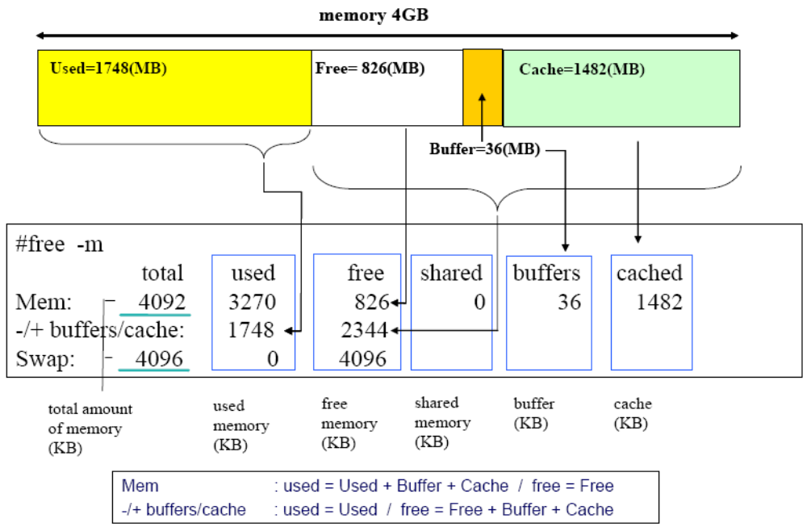
Viewing memory with free
Use free –m to view a summary of memory usage in MiB

Slide 137
Other commands to view memory usage
Page tables
  /proc/vmstat
System memory
  /proc/meminfo
  Total physical memory
  Memory being used by caches
  Active (in use) vs. inactive
Summary
  vmstat -s
  sar -r 1 10
  Report memory and swap space utilization statistics

Slide 138
Characterizing page status
Free
  Page is available for immediate allocation
Inactive Clean
  Page content has been written to disk, or
  Has not changed since being read from disk
  Page is available for allocation
Inactive Dirty
  Page not in use, and
  Page content has been modified but not written back to disk
Active
  Page is in use by a process

Slide 139
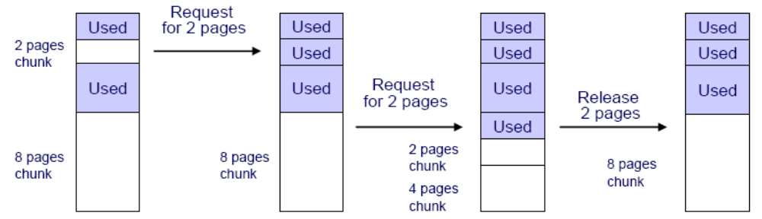
Buddy system
The buddy system maintains free pages and tries to allocate pages for page allocation requests
  It tries to keep the memory area contiguous

Slide 140
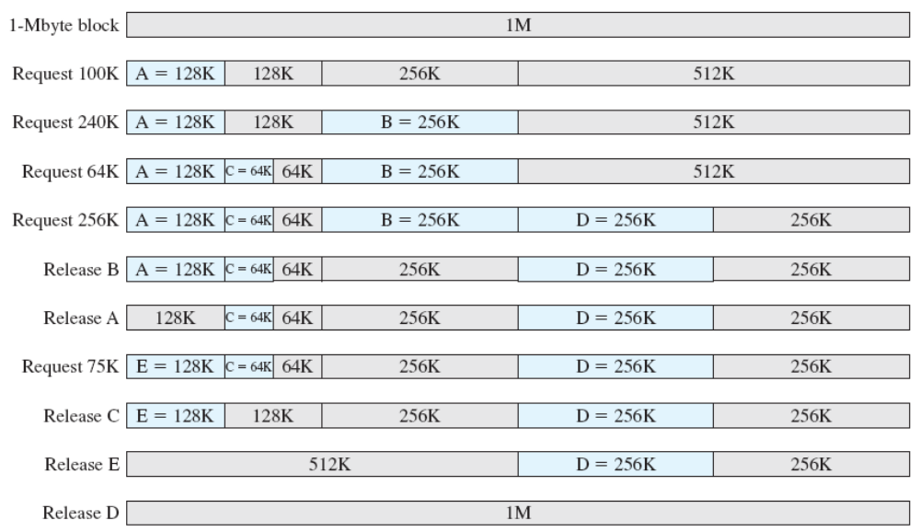
Example of Buddy System

Slide 141
Page frame reclaiming
A kswapd kernel thread swaps out the least recently used pages to maintain a number of free pages
kswapd kernel thread and try_to_free_page() kernel function are responsible for page reclaiming
  While kswapd is usually sleeping in task interruptible state, it is called by the buddy system when free pages in a zone fall short of a threshold
  It tries to find the candidate pages to be taken out of active pages based on the Least Recently Used (LRU) principle
  Can take a look at how much memory is considered as active and inactive using the vmstat -a command

Slide 142
SysV IPC
  semaphores
    kernel.sem
  message queue
    kernel.msgmni
    kernel.msgmnb
    kernel.msgmax
  shared memory
    kernel.shmmni
    kernel.shmmax
    kernel.shmall
free –m

Slide 143
kswapd also follows another principle
  The pages are used mainly for two purposes: page cache and process address space
  The page cache is pages mapped to a file on disk
  The pages that belong to a process address space (called anonymous memory because it is not mapped to any files, and it has no name) are used for heap and stack
  When kswapd reclaims pages, it would rather shrink the page cache than page out (or swap out) the pages owned by processes

Slide 144
Reclaiming dirty pages
Using memory as cache creates a strong need to control how pages are reclaimed
  Memory is volatile
  Dirty pages need to be written to disk
  Free up pages for use by other processes
Handled by pdflush kernel threads
  Default minimum of two threads
  Additional threads created or destroyed according to IO activity
  vm.nr_pdflush_threads show the current number of pdflush threads

Slide 145
Tuning pdflush
Tune length/size of memory
  vm.dirty_background_ratio
  Percentage (of total memory) of number of dirty pages at which pdflush starts writing
  vm.dirty_ratio
  Percentage (of total memory) of number of dirty pages at which a process itself starts writing out dirty data
Tune wait time
  vm.dirty_expire_centisecs
  Interval between pdflush wakeups in 100ths of a second; set to zero to disable writeback
Tune observation period (between pdflush wakeups)
  vm.dirty_writeback_centisecs
  Defines when data is old enough, in 100ths of a second, to be eligible for writeout bye pdflush

Slide 146
Reclaiming clean pages
1. Flush all dirty buffers and pages
  Sync command
  fsync system call
  Alt-SysRq-S magic system request
  echo s > /proc/sysrq-trigger
2. Reclaim clean pages
  echo 3 > /proc/sys/vm/drop_caches
    1 to free pagecache
    2 to free dentries and inodes
    3 to free pagecache, dentries and inodes
  Eliminate bad data from cache
  Reduce memory before laptop hibernate
  Benchmark subsystem

Slide 147
Out-of-memory killer
Kills processes if
  All memory (incl.swap) is active
  No pages are available in ZONE_NORMAL
  No memory is available for page table mappings
Interactive processes are preserved if possible
  High sleep average indecates interactive
  View level of immunity from oom-kill
    /proc/PID/oom_score
Manually invoking oom-kill
  echo f > /proc/sysrq-trigger
  Will call oom_kill to kill a memory hog process
  Does not kill processes if memory is avaliable
  Outputs verbose memory information in /var/log/messages

Slide 148
Tuning OOM policy
Protect daemons from oom-kill
  echo n > /proc/PID/oom_adj
  The process to be killed in an out-of-memory situation is selected based on its badness score
  oom_score gets multiplied by 2^{n}
  Caution: child processes inherit oom_adj from parent
Disable oom-kill in /etc/sysctl.conf
  vm.panic_on_oom = 1
oom-kill is not a fix for memory leaks

Slide 149
Detecting memory leaks
Two types of memory leaks
  Virtual: process requests but does not use virtual address space (vsize)
  Real: process fails to free memory (rss)
Use sar to observer system-wide memory change
  sar -R 1 120
  Report memory statistics
Use watch with ps or pmap
  watch –n1 ‘ps axo pid,comm,rss,vsize | grep httpd’
Use valgrind
  valgrind --tool=memcheck cat /proc/$$/maps

Slide 150
What is swap?
The unmapping of page frames from an active process
  Swap-out: page frames are unmapped and placed in page slots on a swap device
  Swap-in: page frames are read in from page slots on a swap device and mapped into a process address space
Which pages get swapped?
  Inactvie pages
  Anonymous pages
Swap cache
  Contains unmodified swapped-in pages
  Avoids race conditions when multiple processes access a common page frame

Slide 151
Improving swap performance
Defer swap until think time
  Frequent, small swaps
  Swap anonymous pages more readily
Reduce visit count
  Distribute swap areas across maximum of 32 LUNs
  Assign an equal, high priority to multiple swap areas
  Kernel uses highest priority first
  Kernel uses round-robin forswap areas of equal priorty
Reduce service time
  Use partitions, not files
  Place swap areas on lowest numbered partitions of fastest LUNs

Slide 153
Tuning swappiness
Searching for inactive pages can consume the CPU
  On large-memory boxes, finding and unmapping inactive pages consumes more disk and CPU resources than writing anonymous pages to disk
Prefer anonymous pages (higher value)
  vm.swappiness
  Linux prefer to swap anonymous pages when:
    % of memory mapped into page tables + vm.swappiness >= 100
Consequences
  Reduced CPU utilization
  Reduced disk bandwidth

Slide 154
Tuning swap size
Considerations
  Kernel uses two bytes in ZONE_NORMAL to track each page of swap
  Storage bandwidth cannot keep up with RAM and can lead to swaplock
  If memory shorage is severe, kernel will kill user mode process
general guidelines
  Batch compute servers: up to 4 * RAM
  Database server: <= 1 GiB
  Application server: >= 0.5 * RAM
Consequences
  Avoid swaplock

Slide 155
Tuning swap for think time
Swap smaller amounts
  vm.page_cluster
Protect the current process from paging out
  vm.swap_token_timeout
  Used to control how long a process is protected from paging when the system thrashing, measured in seconds
  The value would be useful to tune thrashing behavior
Consequences
  Smoother swap behavior
  Enable current process to clean up its pages

Slide 156
Tuning swap visit count
Create up to 32 swap devices
Make swap signatures
  mkswap -L SWAP_LABEL /path/to/device
Assign priority in /etc/fstab
  /dev/sda1 swap swap pri=5 0 0
  /dev/sdb1 swap swap pri=5 0 0
  LABEL=testswap swap swap pri=5 0 0
  /swaps/swapfile1 swap swap pri=1 0 0
Active
  swapon -a
  View active swap devices in /proc/swaps

Slide 157
Monitoring memory usage
Memory activity
  vmstat -n [interval] [count]
  sar -r [interval] [count]
  Report memory and swap space utilization statistics
Rate of change in memory
  sar -R [interval] [count]
  Report memory statistics
Swap activity
  sar -W [interval] [count]
  Report swapping statistics
All IO
  sar -B [interval] [count]
  Report paging statistics

Slide 158
Virtual memory manager

Slide 159
systemtap
oprofile

Slide 160
I/O Architecture and Device Drivers

Slide 161
Overview
The Virtual File System depends on lower-level functions to carry out each read, write, or other operation in a manner suited to each device
To make a computer work properly, data paths must be provided that let information flow between CPU(s), RAM, and the score of I/O devices that can be connected to a personal computer
These data paths, which are denoted as the buses, act as the primary communication channels inside the computer

Slide 162
Any computer has a system bus that connects most of the internal hardware devices
  A typical system bus is the PCI (Peripheral Component Interconnect) bus
  Several other types of buses, such as ISA, EISA, MCA, SCSI, and USB, are currently in use
  Typically, the same computer includes several buses of different types, linked together by hardware devices called bridges
  Two high-speed buses are dedicated to the data transfers to and from the memory chips
    the frontside bus connects the CPUs to the RAM controller
    the backside bus connects the CPUs directly to the external hardware cache
  The host bridge links together the system bus and the frontside bus

Slide 163
The data path that connects a CPU to an I/O device is generically called an I/O bus
The 80 x 86 microprocessors use 16 of their address pins to address I/O devices and 8, 16, or 32 of their data pins to transfer data
The I/O bus, in turn, is connected to each I/O device by means of a hierarchy of hardware components including up to three elements: I/O ports , interfaces, and device controllers

Slide 164
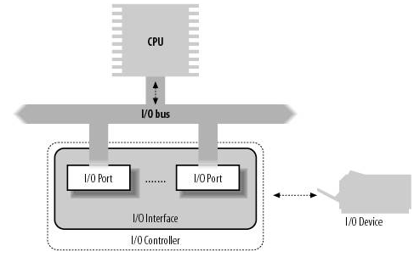
PC's I/O architecture

Slide 165
I/O Ports
Each device connected to the I/O bus has its own set of I/O addresses, which are usually called I/O ports
In the IBM PC architecture, the I/O address space provides up to 65,536 8-bit I/O ports
I/O ports may also be mapped into addresses of the physical address space
  The processor is then able to communicate with an I/O device by issuing assembly language instructions that operate directly on memory (for instance, mov, and, or, and so on)
  Modern hardware devices are more suited to mapped I/O, because it is faster and can be combined with DMA

Slide 166
Access mode affects disk IO
Character
  Sequential IO
  High overhead, low latency
    The kernel will read or write one character to or from the device per device interrupt
  Depending on size of transfers, IO may be buffered
  Simple buffering provides little opportunity for tuning
Block
  Random IO, the unit of transfer files is a block
    For each interrupt, a block’s worth of data is delivered
    Block size can range from 1KiB to PAGE_SIZE
  High average access time but high throughput
  The page is the basic unit used for IO requests
  Complex buffering provides ample opportunity for tuning
    The most general purpose filesystems an associated buffer is created in memory whenever the block device is mounted

Slide 167
读/写，局部性原理
write(), read()
VFS
ext3
xfs
r1
r2
w1
r3
w2
r4
b
c

Slide 169
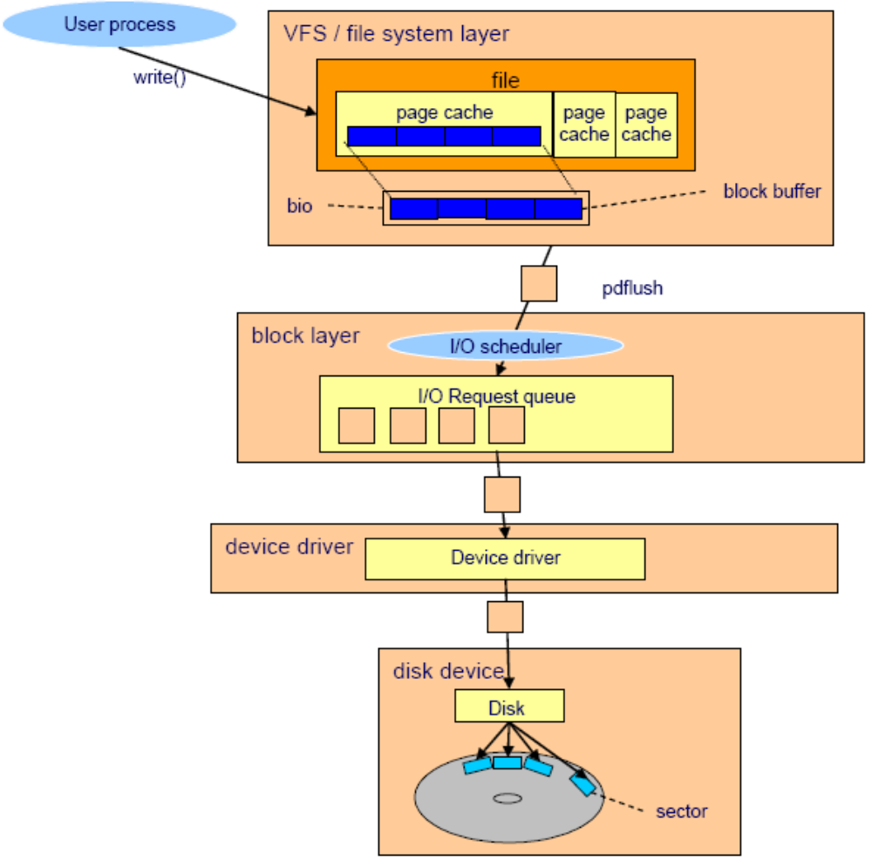
I/O subsystem architecture

Slide 170
Physical factors affect disk IO
Electro-mechanical positioning
  Rotational delay
  Seek time
Storage density: zoned constant angular velocity (ZCAV) drives
  Outer tracks contain more linear storage area
  For a given rotational speed, read more data per second on outer tracks
  Lower partition numbers are on outside
Remember the forced flow law!
  The linux kernel handles more than 10Gib/s for a single stream
  The bus interconnect may be a bottleneck

Slide 171
Flushing a dirty buffer
When a process reads data from disk, the data is copied to memory
  The process and other processes can retrieve the same data from the copy of the data cached in memory
  When a process tries to change the data, the process changes the data in memory first
  At this time, the data on disk and the data in memory is not identical and the data in memory is referred to as a dirty buffer
  The dirty buffer should be synchronized to the data on disk as soon as possible, or the data in memory could be lost if a sudden crash occurs

Slide 172
The synchronization process for a dirty buffer is called flush
In the Linux kernel 2.6 implementation, pdflush kernel thread is responsible for flushing data to the disk
  The flush occurs on a regular basis (kupdate) and when the proportion of dirty buffers in memory exceeds a certain threshold (bdflush). The threshold is configurable in the /proc/sys/vm/dirty_background_ratio file

Slide 173
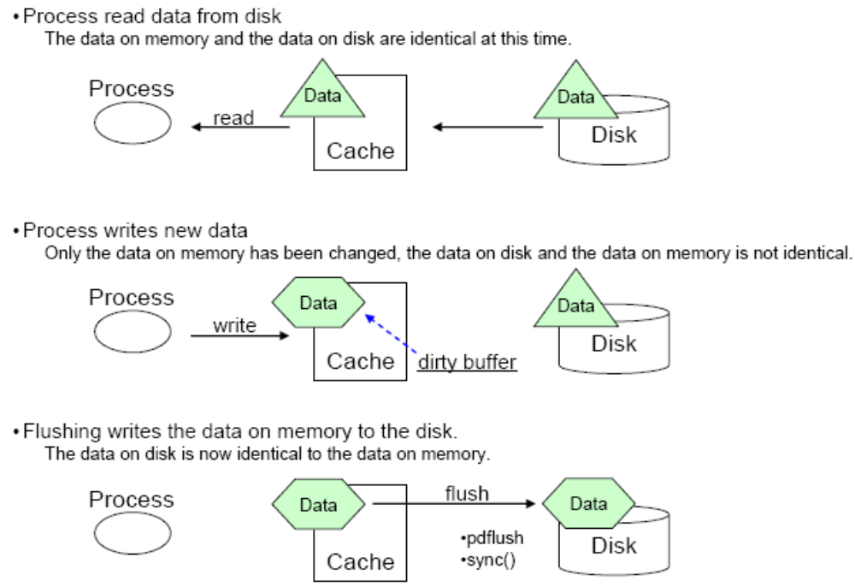
Flushing dirty buffers

Slide 174
Block layer
The block layer handles all the activity related to block device operation
The key data structure in the block layer is the bio structure
The bio structure is an interface between the file system layer and the block layer
  When a write is performed, the file system layer tries to write to the page cache which is made up of block buffers
  It makes up a bio structure by putting the contiguous blocks together, then sends bio to the block layer

Slide 175
Block device IO transfers
Two distinct steps to service an IO reques
  1. Place the IO request on a request queue
    Each block device has its own request queue that combines reads and writes
    Empty request queues are plugged before a new request is added
  2. Perform the transfer at some later point in time
Direct IO bypasses the buffer layer
  Used for self-caching applications
  Avoids duplicate content in page frames
  Read/Write system calls are slowed down by page cache and read-ahead

Slide 176
Improving buffer efficiency
Use larger request queue length
  Allows reads to be sorted before wirtes
  Longer queues allow more efficient re-sorting
  Introduces more latency
Kernel automatically reads ahead sequentially
  Fewer seeks
  Fewer operations issued to disk controller
  Reduces wait time
  Stopped when random file access is detected

Slide 177
Tuning buffers
Queue length
  /sys/block/<dev>/queue/nr_requests
Max read-ahead
  /sys/block/<dev>/queue/read_ahead_kb
  Note: initial read-ahead window size is half the max
Persist in /etc/rc.local

Slide 178
The IO scheduler
The block layer handles the bio request and links these requests into a queue called the I/O request queue
This linking operation is called I/O elevator
Compensate for physical factors by re-sorting request queue
  Referred to as merging
  Measuring rrqm/s and wrqm/s
    iostat -x sda 1 10
Conflicting goals
  Keep disk head moving in one direction as long as possible,but
  Prevent IO starvation (i.e., minimize wait time)

Slide 179
The Job of an I/O Scheduler
An I/O scheduler works by managing a block device’s request queue
  It decides the order of requests in the queue and at what time each request is dispatched to the block device
It manages the request queue with the goal of reducing seeks, which results in greater global throughput
I/O schedulers perform two primary actions to minimize seeks: merging and sorting

Slide 180
Sorting the IO queues
One elevator algorithm per LUN or whole block device
CFQ(default)
  Divides IO bandwidth equally among all processes
Deadline
  Optimize read and wirte queue times
  Request must be serviced when expiration time is reached
  When possible, multiple requests are served from new location
Anticipatory
  Optimize service time for dependent reads
  After servicing an IO, wait a short time to give the process a chance to submit another IO
NOOP
  IO requests are placed in queue with minimal processing
  Schedualing is left to the hardware
  Use only when CPU clock cycles are too expencive

Slide 181
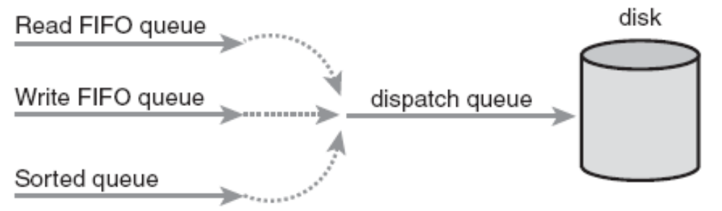
The Deadline I/O Scheduler
  In the Deadline I/O scheduler, each request is associated with an expiration time
    By default, the expiration time is 500 milliseconds in the future for read requests and 5 seconds in the future for write requests
  It is a tough act to provide request fairness, yet maximize global throughput

Slide 183
Tuning the deadline scheduler
Selection
  echo deadline > /sys/block/<dev>/queue/scheduler
Tunables in /sys/block/<dev>/queue/iosched/
  Max queue time
    read_expire (in ms)
    write_expire (in ms)
  Number of requests to move from the scheduler list to the request queue
    fifo_batch
  How many reads to allow before a write is dispatched
    wirtes_startved
  Should we attempt to front-merge contiguous requests?
    front_merges

Slide 184
The Anticipatory I/O Scheduler
  The anticipatory I/O elevator was created based on the assumption of a block device with only one physical seek head (for example a single SATA drive)
  The Anticipatory I/O scheduler aims to continue to provide excellent read latency, but also provide excellent global throughput
  The Anticipatory I/O scheduler attempts to minimize the seek storm that accompanies read requests issued during other disk I/O activity
    When a read request is issued, it is handled as usual, within its usual expiration period
    After the request is submitted, however, the Anticipatory I/O scheduler does not immediately seek back and return to handling other requests
    Instead, it does absolutely nothing for a few milliseconds

Slide 185
Tuning the anticipatory scheduler
Selection
  echo anticipatory > /sys/block/<dev>/queue/scheduler
Tunables in /sys/block/<dev>/queue/iosched/
  How long to wait for another, nearby read
    antic_expire
  Max queue time
    read_expire
    write_expire
  How long to batch-process reads or writes
    read_batch_expire
    write_batch_expire

Slide 186
The Complete Fair Queuing I/O Scheduler
  The CFQ I/O scheduler assigns incoming I/O requests to specific queues based on the process originating the I/O request
  The CFQ I/O scheduler then services the queues round robin, plucking a configurable number of requests (by default, four) from each queue before continuing on to the next
  This provides fairness at a per-process level, assuring that each process receives a fair slice of the disk’s bandwidth

Slide 187
Tuning the cfq scheduler
Selection
  echo cfq > /sys/block/<dev>/queue/scheduler
  Uses 64 internal queues
  Fills internal queues using round-robin
  Requests are dispatched from non-empty queues
  Sort occurs at dispatch queue
Tunables in /sys/block/<dev>/queue/iosched/
  Nubmer of requests dispatched to device per cycle
    quantum
    slice_idle = 1
    quantum = 64
    group_idle = 1

Slide 188
The Noop I/O Scheduler
  The Noop I/O scheduler does not perform sorting or any other form of seek-prevention whatsoever
  In turn, it has no need to implement anything akin to the slick algorithms to minimize request latency that you saw in the previous three I/O schedulers
  The Noop I/O scheduler does perform merging, however, as its lone chore
  It is intended for block devices that are truly random-access, such as flash memory cards

Slide 189
Tuning the noop scheduler
Selection
  echo noop > /sys/block/<dev>/queue/scheduler
  No tunable settings required
Use when CPU clock cycles are “too expensive”
  Host CPU cycles are usually cheaper than SAN CPU cycles
  Sorting is still usefule for iSCSI
Some controllers perform elevator functions
  Tagged command queuing
  Available on SCSI and some SATA drives

Slide 190
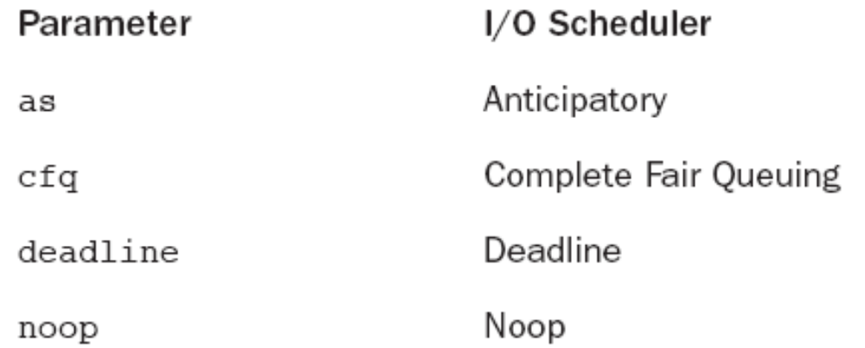
I/O Scheduler Selection
Each of these I/O schedulers can be enabled and built into the kernel
By default, block devices use the Complete Fair Queuing I/O scheduler
This can be overridden via the boot-time option elevator= ele_name

Slide 191
Linux file systems

Slide 192
I/O scheduler
  CFQ
  deadline
  anticipatory
  noop (matlab)

Slide 193
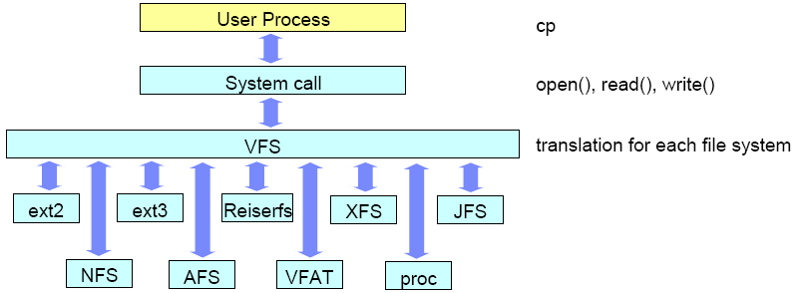
Virtual file system
Virtual Files System (VFS) is an abstraction interface layer that resides between the user process and various types of Linux file system implementations

Slide 194
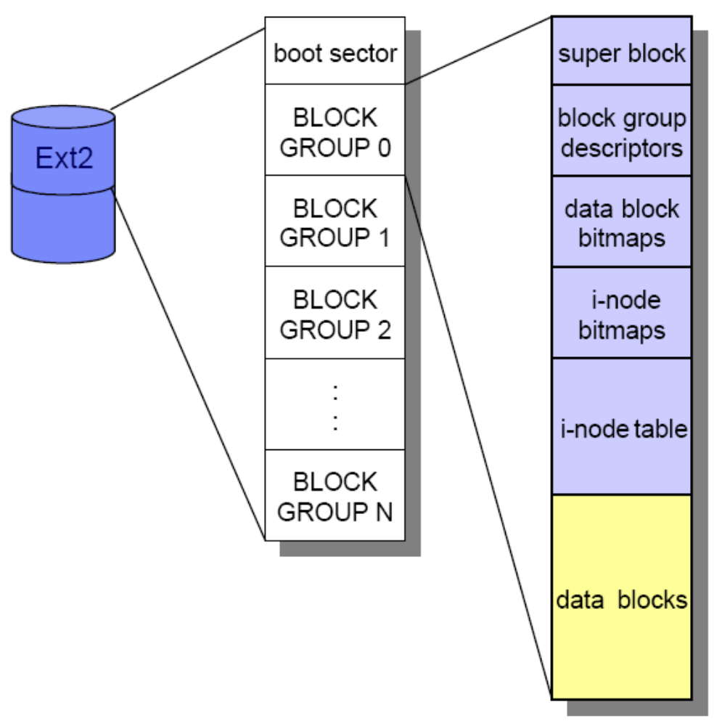
Ext2

Slide 195
block: page frame
  2^n
  2^2=4096
  500G
  block groups： 块组

Slide 196
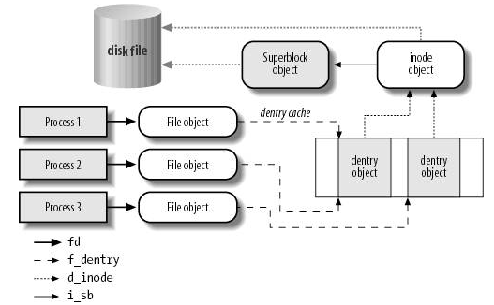
Interaction between processes and VFS objects

Slide 197
Fragmentation
Increates average time of sequential reads
Ext2 and ext3 use reserved space to reduce fragmentation
  Pre-allocated up to 8 blocks
  Unused blocks are freed when file is closed
  At file creation, inode is created in a block group different than directory (if possible)
  When extending a file, uses blocks in same block group if possible
  Problematic if partition is close to full

Slide 198
16k,4
a.txt, 2K, 1K, 6blocks
b.txt, reserved blocks

Slide 199
Viewing fragmentation
For a specific file
  filefrag -v /path/to/file
For a mounted filesystem
  dumpe2fs /dev/some_device_partition
For an unmounted filesystem (boot-time)
  fsck /dev/some_device

Slide 200
mount –o noatime
mount –o commit=15

Slide 201
Tuning fragmentation
At filesystem creation
  mke2fs -m reserved-percentage
After filesystem creation
  tune2fs -m reserved-percentage
  tune2fs -r reserved-block-count
Considerations
  Too low may degrade performance
  Too high wastes capacity

Slide 202
Filesystem limits
Maximum file size
  ext3: 2 TiB
  GFS: 16 TiB (x86/32-bit) or 8 EiB (x86/64-bit)
Maximum file system size
  ext3: 16 TiB
  GFS: 16 TiB (x86/32-bit) or 8 EiB (x86/64-bit)

Slide 203
Journaling
In a non-journaling file system, when a write is performed to a file system the Linux kernel makes changes to the file system metadata first and then writes actual user data next
A Journaling file system writes data to be changed to the area called the journal area before writing the data to the actual file system
  The journal area can be placed both in the file system or out of the file system
  The data written to the journal area is called the journal log
  It includes the changes to file system metadata and the actual file data if supported

Slide 204
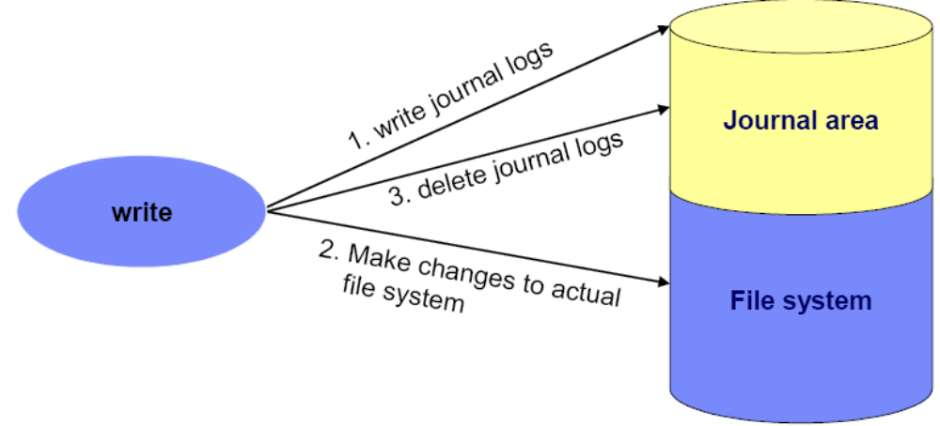
Journaling concept
Journaling involves two writes to disk
  Write modified blocks to journal
  Write modified blocks to filesystem
  Discard blocks in journal

Slide 205
Mode of journaling
Ext3 supports three types of journaling modes
  journal
    Provides the highest form of data consistency by causing both file data and metadata to be journaled
    It also has higher performance overhead
  ordered
    In this mode only metadata is written
    However, file data is guaranteed to be written first
    This is the default setting
  writeback
    Provides the fastest access to the data at the expense of data consistency

Slide 206
Journaling
Which blocks?
  Only the metadata (default)
    mount –o data=ordered
  Data and metadata
    mount –o data=journal
  Only the metadata, but no guarantee for order of commits
    mount –o data=writeback
Consequence
  Reduce time for consistency check after a system crash
  data=journal avoids expensive seeks by resorting small, random writes

Slide 207
Improving journal performance
By default, journal is located at an inode within the filesystem
  Journal size can be from 1024 to 102400 blocks
    mke2fs –b 4096 -J size=32 /dev/sdb1 (Note: size in MiB)
Place journal on a separate device
  Data journaling is a mount-time option, so journal device and filesystem must use identical block size
  Entire partition must be dedicated to journal device
  Major:Minor device number of journal device is recorded in filesystem superblock
Consequences
  Reduce visit count
  Reduce service time for both journal and filesystem

Slide 208
Tuning journal placement
1. Umount filesystem
2. Confirm filesystem block size and journal placement
  dumpe2fs /dev/sdb1 | less
3. Remove the internal journal from the existing filesystem
  tune2fs -O ^has_journal /dev/sdb1
4. Create an external journal device
  mke2fs –O journal_dev -b block-size /dev/sdc1
5. Update the filesystem superblock to use the external journal
  tune2fs -j -J device=/dev/sdc1 /dev/sdb1

Slide 209
Other mount-time options
Consider disabling access time updates
  mount –o noatime
  May have a significant impace on ext3 performance
Mount ext3 with longer period between journal commits
  mount -o commit=15
  Default is 5 seconds
  Longer may improve performance but result in more lost data if system crashes

Slide 210
Finding lock contention
Types of locks
  Advisory (cooperative)
  Mandatory (enforced by kernel)
    chmod g+s-x /path/to/file
Heavily used by databases
View current locks held by processes
  cat /proc/locks

Slide 211
Filesystems comparison using iozone
iozone
  IOzone is a filesystem benchmark tool
    The benchmark generates and measures a variety of file operations
  Iozone is useful for performing a broad filesystem analysis of a vendor’s computer platform
  The benchmark tests file I/O performance for the following operations:
    Read, write, re-read, re-write, read backwards, read strided, fread, fwrite, random read, pread ,mmap, aio_read, aio_write

Slide 212
iozone
  -i

Slide 213
The options of iozone
-a
  Used to select full automatic mode
  Produces output that covers all tested file operations for record sizes of 4k to 16M for file sizes of 64k to 512M
-b filename
  Creates a binary file format file in Excel compatible output of results
-R
  Generate Excel report
  Iozone will generate an Excel compatible report to standard out
-z
  Used in conjunction with -a to test all possible record sizes

Slide 214
-f filename
  Used to specify the filename for the temporary file under test
-g #
  Set maximum file size (in Kbytes) for auto mode
-n #
  Set minimum file size (in Kbytes) for auto mode
-s #
  Used to specify the size, in Kbytes, of the file to test
  One may also specify -s #k (size in Kbytes) or -s #m (size in Mbytes) or -s #g (size in Gbytes)

Slide 215
-y #
  Set minimum record size (in Kbytes) for auto mode
  One may also specify -y #k (size in Kbytes) or -y #m (size in Mbytes) or -y #g (size in Gbytes)
-q #
  Set maximum record size (in Kbytes) for auto mode
-r #
  Used to specify the record size, in Kbytes, to test

Slide 216
-i #
  Used to specify which tests to run
    0=write/rewrite
    1=read/re-read
    2=random-read/write
    3=Read-backwards
    4=Re-write-record
    5=stride-read
    6=fwrite/re-fwrite
    7=fread/Re-fread,
    8=random mix
    9=pwrite/Re-pwrite
    10=pread/Re-pread
    11=pwritev/Re-pwritev
    12=preadv/Repreadv
  -i # -i # -i # is also supported so that one may select more than one test

Slide 217
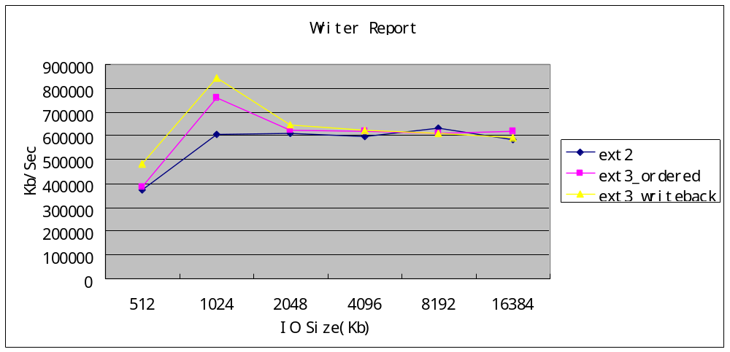
/test is the mount point
iozone -a -s 128M -y 512 -q 16384 -i 0 -i 1 -i 2 -f /test/a.out -Rb /root/ext3_writeback.out

Slide 218
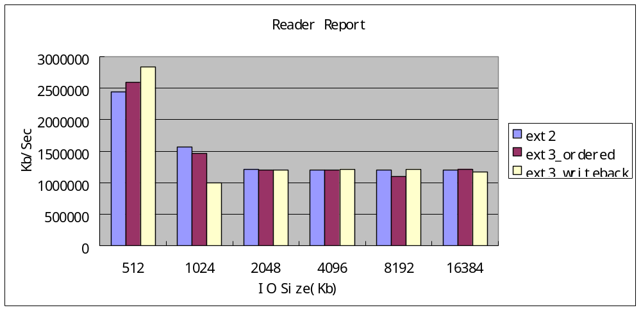

Slide 219
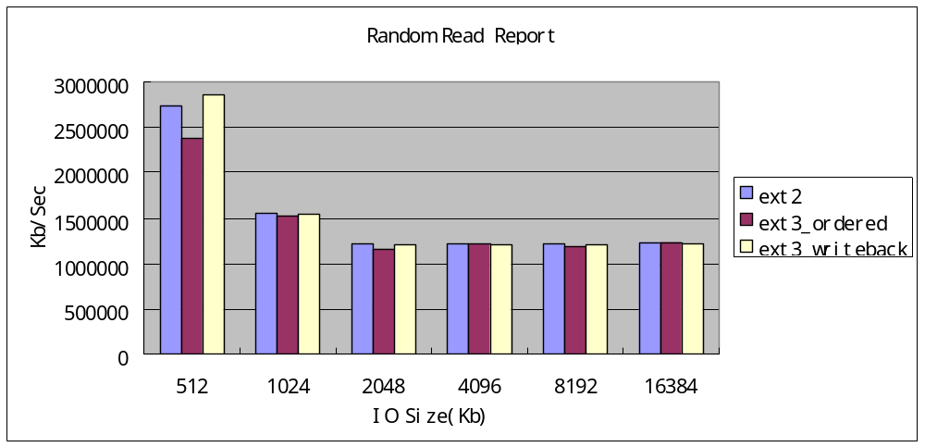

Slide 220
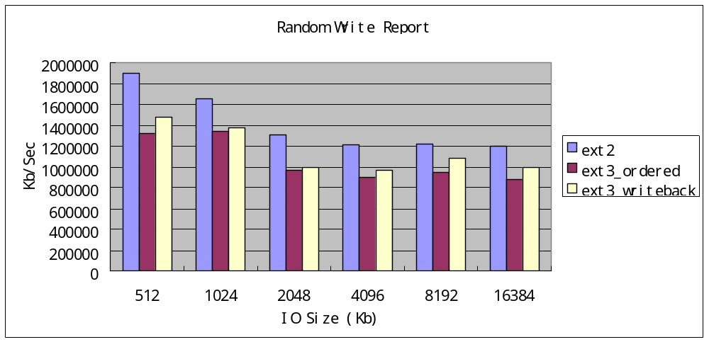

Slide 221
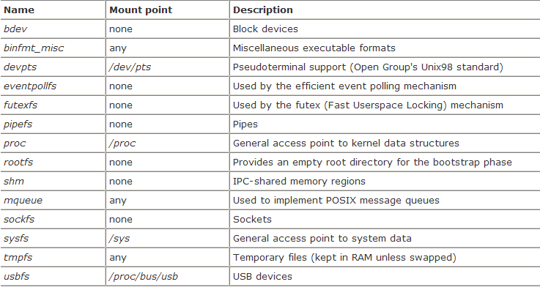
Most common special filesystems

Slide 222
Interrupts and Exceptions

Slide 223
poll(轮询)
Interrupt
Exception
  缺页异常
PIC
register

Slide 224
Interrupts Overview
An interrupt is usually defined as an event that alters the sequence of instructions executed by a processor
  Interrupts enable hardware to signal to the processor
  The processor receives the interrupt and signals the operating system to enable the operating system to respond to the new data
  Events correspond to electrical signals generated by hardware circuits both inside and outside the CPU chip
Interrupts are issued by interval timers and I/O devices; for instance, the arrival of a keystroke from a user sets off an interrupt

Slide 225
Interrupts are often divided into synchronous and asynchronous interrupts
  Synchronous interrupts are produced by the CPU control unit while executing instructions and are called synchronous because the control unit issues them only after terminating the execution of an instruction
  Asynchronous interrupts are generated by other hardware devices at arbitrary times with respect to the CPU clock signals
Intel microprocessor manuals designate synchronous and asynchronous interrupts as exceptions and interrupts, respectively

Slide 226
Exceptions, on the other hand, are caused either by programming errors or by anomalous conditions that must be handled by the kernel
  In the first case, the kernel handles the exception by delivering to the current process one of the signals familiar to every Unix programmer
  In the second case, the kernel performs all the steps needed to recover from the anomalous condition, such as a Page Fault or a requestvia an assembly language instruction such as int or sysenter for a kernel service

Slide 227
The Role of Interrupt Signals
When an interrupt signal arrives, the CPU must stop what it's currently doing and switch to a new activity; it does this by saving the current value of the program counter (i.e., the content of the eip and cs registers) in the Kernel Mode stack and by placing an address related to the interrupt type into the program counter
But there is a key difference between interrupt handling and process switching: the code executed by an interrupt or by an exception handler is not a process
  It is a kernel control path that runs at the expense of the same process that was running when the interrupt occurred
  A kernel control path, the interrupt handler is lighter than a process

Slide 228
Interrupt handling is one of the most sensitive tasks performed by the kernel, because it must satisfy the following constraints:
  Interrupts can come anytime, when the kernel may want to finish something else it was trying to do
    The kernel's goal is therefore to get the interrupt out of the way as soon as possible and defer as much processing as it can
  Because interrupts can come anytime, the kernel might be handling one of them while another one (of a different type) occurs
  Although the kernel may accept a new interrupt signal while handling a previous one, some critical regions exist inside the kernel code where interrupts must be disabled

Slide 229
IRQs and Interrupts
Each hardware device controller capable of issuing interrupt requests usually has a single output line designated as the Interrupt ReQuest (IRQ) line
All existing IRQ lines are connected to the input pins of a hardware circuit called the Programmable Interrupt Controller
  The IRQ lines are sequentially numbered starting from 0; therefore, the first IRQ line is usually denoted as IRQ 0
  Each IRQ line can be selectively disabled

Slide 230
Interrupt Handlers
The function the kernel runs in response to a specific interrupt is called an interrupt handler or interrupt service routine (ISR)
  Each device that generates interrupts has an associated interrupt handler
  They run in a special context called interrupt context
  Because an interrupt can occur at any time, an interrupt handler can, in turn, be executed at any time

Slide 231
Top Halves Versus Bottom Halves
These two goals—that an interrupt handler execute quickly and perform a large amount of work—clearly conflict with one another
Because of these competing goals, the processing of interrupts is split into two parts, or halves
  The interrupt handler is the top half
  Work that can be performed later is deferred until the bottom half

Slide 232
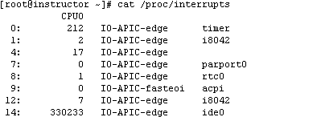
/proc/interrupts
A proc file populated with statistics related to interrupts on the system
  The first column is the interrupt line
  The second column is a counter of the number of interrupts received
  The third column is the interrupt controller handling this interrupt
  The last column is the device associated with this interrupt

Slide 233
Network subsystem

Slide 234
Tcp/ip: kernel
10W

Slide 235
UDP: 核心缓冲
TCP: 套接字缓冲

Slide 236
OSI
  TCP
    Listening
    Closed
    SYN_SENT
    SYN_RECV
    ESTABLISHED
    TIME-WAIT 1
    CLOSE-WAIT
    TIME-WAIT 2
    LAST-ACK
    CLOSE WAIT
    CLOSED
  UDP

Slide 237
Overview
The network subsystem is another important subsystem in the performance perspective
Networking operations interact with many components other than Linux such as switches, routers, gateways, PC clients, and so on
Though these components might be out of the control of Linux, they have a lot of influence on the overall performance

Slide 239
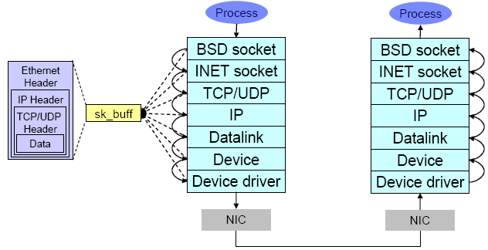
Networking implementation
Network layered structure and overview of networking operation

Slide 240
Fra
Ip
tcp

Slide 241
30000
prefork
  socket file

Slide 242
Network sockets
Socket ties application to network stack for reading and writing
Each socket (network connection) is treated like a virtal file
  Write to the file to transmit data
  Read from the file to receive data
  Close the socket to destroy the file
Read and write socket buffer store data for application
TCP sockets require extra connection handling

Slide 243
The sequence that outlines the fundamental operations that occur during network data transfer
  When an application sends data to its peer host, the application creates its data
  The application opens the socket and writes the data through the socket interface
  The socket buffer is used to deal with the transferred data
    The socket buffer has reference to the data and it goes down through the layers
  In each layer, appropriate operations such as parsing the headers, adding and modifying the headers, check sums, routing operation, fragmentation, and so on are performed

Slide 244
  Finally, the data goes out to the wire from the network interface card
  The Ethernet frame arrives at the network interface of the peer host
  The frame is moved into the network interface card buffer if the MAC address matches the MAC address of the interface card
  The network interface card eventually moves the packet into a socket buffer and issues a hard interrupt at the CPU
  The CPU then processes the packet and moves it up through the layers until it arrives at (for example) a TCP port of an application such as Apache

Slide 245
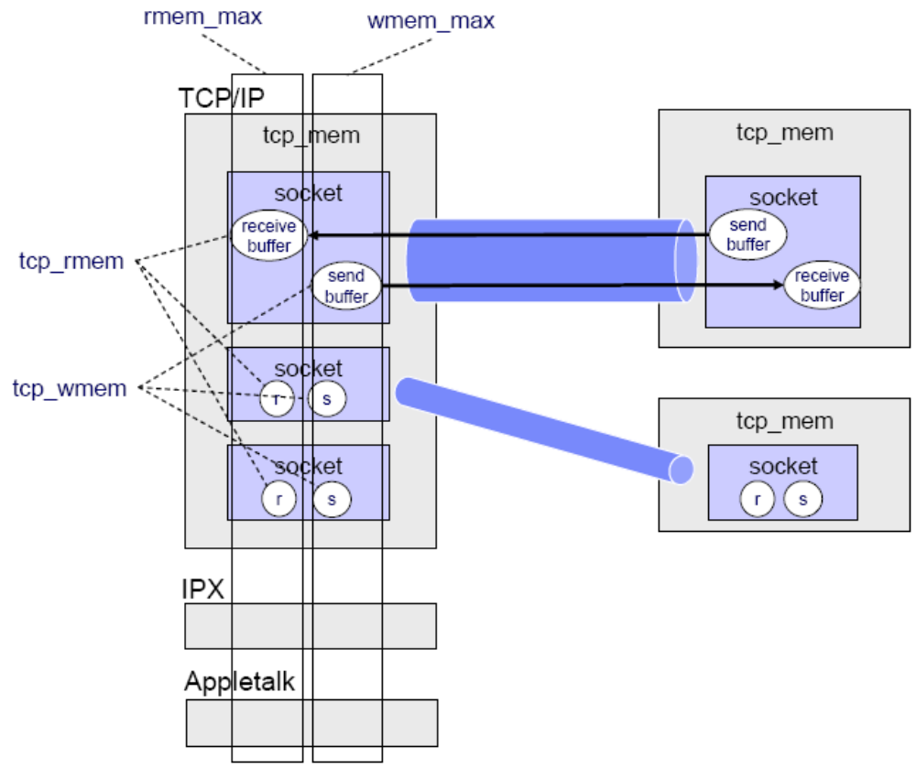
Socket buffer
The kernel uses buffers to send and receive data

Slide 246
Simplified transmit model
Output/writer
  * Write data to socket “file” (goes in transmit buffer)
  Kernel encapsulates data into protocol data units
  * PDUs are moved to per-device transmit queue
  Driver copies PDU from head of queue to NIC
  * NIC raises interrupt when PDU transmitted
  * essential tuning points

Slide 247
Simplified receive model
Input/reader
  * NIC receives frame and uses DMA to copy into receive buffer
  NIC raises CPU interrupt
  Kernel handles interrupt and schedules a softirq
  Softirq is handled to move packets up to the IP layer for routing decision
  If local delivery
    Decapsulate packet and place into socket’s receive buffer
    Wake the processes in the socket’s wait queue
    Process reads from socket (receive buffer)
  * essential tuning points

Slide 248
Network API (NAPI)
In the traditional approach of handling network packets, the network interface card eventually moves the packet into a network buffer of the operating systems kernel and issues a hard interrupt at the CPU
  Every time an Ethernet frame with a matching MAC address arrives at the interface, there will be a hard interrupt
NAPI was introduced to counter the overhead associated with processing network traffic
  For the first packet, NAPI works just like the traditional implementation as it issues an interrupt for the first packet
  But after the first packet, the interface goes into a polling mode

Slide 249
TCP sockets
Open with three-way hankshake
  Client sends syn packet
  Server replies with syn-ack packet
  Client sends ack packet
Systems terminate socket independently
  One side sends fin packets
  Remote side replies with fin-ack packet
  Idle connections may be considered dead
  Requires the use of keepalives
  Half-closed connection terminated after default timeout if FIN-ACK not received

Slide 250
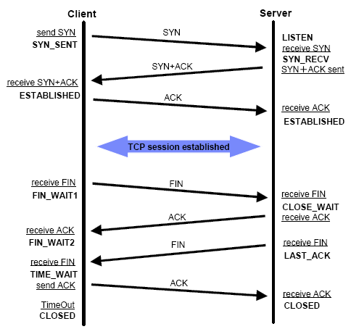
TCP 3-way handshake

Slide 251
Viewing network sockets
Passive opens (listeners)
  netstat -tunlp
Active sockets
  sar -n SOCK
  lsof -l
  netstat -tu
All sockets
  netstat -taupe
Half-closed connections
  netstat -tapn | grep TIME_WAIT

Slide 252
Tuning TCP socket creation
Number of times initial SYNs for an active TCP connection attempt will be retransmitted
  net.ipv4.tcp_sync_retries
  Should not be higher than 255
  The default value is 5
Listener queue length for unacknowledged connection attempts
  net.ipv4.tcp_max_syn_backlog
  Maximum number of remembered connection requests, which are still did not receive an acknowledgment from connecting client. default 1024
Reusing TCP connections
  net.ipv4.tcp_tw_recycle

Slide 253
Tuning TCP socket keepalive
Wait time before sending first keepalive
  net.ipv4.tcp_keepalive_time
  default: 2hours
How often to send keepalive probes
  net.ipv4.tcp_keepalive_intvl
  default: 75secs
How many probes to send
  net.ipv4.tcp_keepalive_probes
  default: 9
  If no ACK response is received for nine consecutive times, the connection is marked as broken

Slide 254
Kernel socket buffers
Kernel buffers
  Core read and write buffers apply to non-TCP protocols
  TCP window size
  Fragmentation for receive/read
  DMA for NIC receive
Kernel adjusts size of buffers automatically
  Buffers require non-pageable memory
  Put pressure on ZONE_NORMAL
  Receiver controls flow based on receive buffer size

Slide 255

Improving buffer sizes
Transmit continuously to maximize throughput
Bandwidth delay product (BDP)
  In data communications, bandwidth-delay product refers to the product of a data link's capacity (in bits per second) and its end-to-end delay (in seconds)
    The result, an amount of data measured in bits (or bytes), is equivalent to the maximum amount of data on the network circuit at any given time, i.e. data that has been transmitted but not yet received
    Sometimes it is calculated as the data link's capacity times its round trip time (RTT)

Slide 256
Improving buffer sizes
Computing the BDP
  Total buffers = Bandwidth*Delay
  Examples
    Residential DSL: 2 Mb/s, 50 ms RTT
      B×D = 2×10⁶ b/s × 50×10⁻³ s = 100×10³ b, or 100 kb / 12.5 kB
    High-speed terrestrial network: 1 Gb/s, 1 ms RTT
      B×D = 10⁹ b/s × 10⁻³ s = 10⁶ b, or 1 Mb / 125 kB

Slide 257
Tuning core buffer size
1. Update /etc/sysctl.conf for BDP/#connec-tions
  Input/reader in Bytes
    net.core.rmem_default
    net.core.rmem_max
  Output/writer in Bytes
    net.core.wmem_default
    net.core.wmem_max
2. Reload /etc/sysctl.conf
  sysctl -p
3. Restart affected services

Slide 258
TCP window size
TCP is a sliding window, not stop-n-wait protocol
  TCP window scaling is enabled by default
  Initial segment size is negotiated during socket creation
  Must resend data not ACKed by receiver
Must limit segment size based on
  Latest rwnd sent by the receiver
  Amount of unACKed data already transmitted
  tcp_window_scaling=1

Slide 259
Window size
In computer networking, RWIN (TCP Receive Window) is the amount of data that a computer can accept without acknowledging the sender
  If the sender has not received acknowledgement for the first packet it sent, it will stop and wait and if this wait exceeds a certain limit, it may even retransmit
  Even if there is no packet loss in the network, windowing can limit throughput
  Throughput ≦ RWIN/RTT

Slide 260
Tuning TCP window size
1. Tune core buffers for BDP/#connections
2. Update /etc/sysctl.conf for BDP/#connec-tions
  Overall TCP memory in pages
    net.ipv4.tcp_mem
    min defalut max
  Input/reader in Bytes
    net.ipv4.tcp_rmem
  Output/writer in Bytes
    net.ipv4.tcp_wmem
3. Reload /etc/sysctl.conf
4. Restart affected services

Slide 261
Tuning fragmentation buffers
Maximum memory used to reassemble IP fragments
  net.ipv4.ipfrag_high_thresh
Minimum memory used to reassemble IP fragments
  net.ipv4.ipfrag_low_thresh
Time in seconds to keep an IP fragment in memory
  net.ipv4.ipfrag_time
  Expiration time for fragments
  The default value is 30 seconds

Slide 262
Viewing fragmentation statistics
Summary statistics
  netstat -s
View reassembly failures
  cat /proc/net/snmp | grep ‘^Ip:’ | cut -f17 -d’ ’
  Reassembly failures indicate a need to tune buffer
Causes of fragmentation
  Denial of Service (DoS) attacks
  NFS
  Noisy networks
  Failing network electronics

Slide 263
Other kernel parameters
net.ipv4.tcp_tw_reuse
  Allow to reuse TIME-WAIT sockets for new connections when it is safe from protocol viewpoint
tcp_syncookies
  Send out syncookies when the syn backlog queue of a socket overflows
  This is to prevent against the common "syn flood attack"
tcp_max_orphans
  Maximal number of TCP sockets not attached to any user file handle, held by system
  This limit exists only to prevent simple DoS attacks
  Must not rely on this or lower the limit artificially, but rather increase it

Slide 264
back_log

Slide 266
tcp_fin_timeout
  Time to hold socket in state FIN-WAIT-2, if it was closed by our side
  Peer can be broken and never close its side, or even die unexpectedly
  FIN-WAIT-2 sockets are less dangerous than FIN-WAIT-1, because they eat maximum 1.5 kilobytes of memory, but they tend to live longer
tcp_max_tw_buckets
  Maximal number of timewait sockets held by system simultaneously
  This limit exists only to prevent simple DoS attacks, you must not lower the limit artificially, but rather increase it

Slide 267
net.core.somaxconn
  Limit of socket listen() backlog, known in userspace as SOMAXCONN
netdev_max_backlog
  Maximum number of packets, queued on the input side, when the interface receives packets faster than kernel can process them
  Applies to non-NAPI devices only
  The default value is 1000

Slide 268
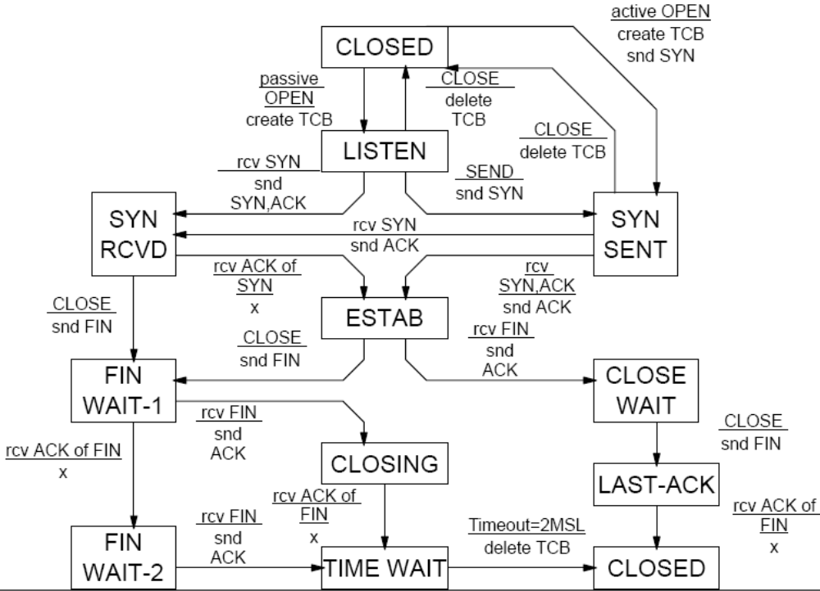
TCP connection state diagram

Slide 269
http://172.16.100.1/images/logo.jpg
proxy /test/ ajp://172.16.100.12/test/

Slide 270
Understanding Linux performance metrics

Slide 271
Processor metrics
CPU utilization
  This is probably the most straightforward metric
  It describes the overall utilization per processor
User time
  Depicts the CPU percentage spent on user processes, including nice time
  High values in user time are generally desirable because, in this case, the system performs actual work
System time
  Depicts the CPU percentage spent on kernel operations including IRQ and softirq time
  High and sustained system time values can point you to bottlenecks in the network and driver stack

Slide 272
Waiting
  Total amount of CPU time spent waiting for an I/O operation to occur
  Like the blocked value, a system should not spend too much time waiting for I/O operations; otherwise youshould investigate the performance of the respective I/O subsystem
Idle time
  Depicts the CPU percentage the system was idle waiting for tasks
Nice time
  Depicts the CPU percentage spent on re-nicing processes that change the execution order and priority of processes

Slide 273
Load average
  The load average is not a percentage, but the rolling average of the sum of the following:
    The number of processes in queue waiting to be processed
    The number of processes waiting for uninterruptable task to be completed
  That is, the average of the sum of TASK_RUNNING and TASK_UNINTERRUPTIBLE processes
Runable processes
  This value depicts the processes that are ready to be executed
  This value should not exceed 10 times the amount of physical processors for a sustained period of time; otherwise a processor bottleneck is likely

Slide 274
Blocked
  Processes that cannot execute while they are waiting for an I/O operation to finish
  Blocked processes can point you toward an I/O bottleneck
Context switch
  Amount of switches between threads that occur on the system
  High numbers of context switches in connection with a large number of interrupts can signal driver or application issues
Interrupts
  Hard interrupts have a more adverse effect on system performance
  High interrupt values are an indication of a software bottleneck, either in the kernel or a driver

Slide 275
Memory metrics
Free memory
Swap usage
  This value depicts the amount of swap space used
  Swap In/Out is a reliable means of identifying a memory bottleneck
  Values above 200 to 300 pages per second for a sustained period of time express a likely memory bottleneck
Buffer and cache
  Cache allocated as file system and block device cache
Slabs
  Depicts the kernel usage of memory
Active versus inactive memory
  Inactive memory is a likely candidate to be swapped out to disk by the kswapd daemon

Slide 276
Network interface metrics
Packets received and sent
Bytes received and sent
Collisions per second
  This value provides an indication of the number of collisions that occur on the network that the respective interface is connected to
  Sustained values of collisions often concern a bottleneck in the network infrastructure, not the server
  On most properly configured networks, collisions are very rare unless the network infrastructure consists of hubs

Slide 277
Packets dropped
  This is a count of packets that have been dropped by the kernel, either due to a firewall configuration or due to a lack of network buffers
Overruns
  Represent the number of times that the network interface ran out of buffer space
  This metric should be used in conjunction with the packets dropped value to identify a possible bottleneck in network buffers or the network queue length
Errors
  The number of frames marked as faulty
  This is often caused by a network mismatch or a partially broken network cable
  Partially broken network cables can be a significant performance issue for copper-based gigabit networks

Slide 278
Block device metrics
Iowait
  Time the CPU spends waiting for an I/O operation to occur
  High and sustained values most likely indicate an I/O bottleneck
Average queue length
  Amount of outstanding I/O requests
  In general, a disk queue of 2 to 3 is optimal; higher values might point toward a disk I/O bottleneck
Average wait
  A measurement of the average time in ms it takes for an I/O request to be serviced
  The wait time consists of the actual I/O operation and the time it waited in the I/O queue

Slide 279
Transfers per second
  Depicts how many I/O operations per second are performed (reads and writes)
  The transfers per second metric in conjunction with the kBytes per second value helps you to identify the average transfer size of the system
  The average transfer size generally should match with the stripe size used by your disk subsystem
Blocks read/write per second
  This metric depicts the reads and writes per second expressed in blocks of 1024 bytes as of kernel 2.6
  Earlier kernels may report different block sizes, from 512 bytes to 4 KB

Slide 280
Kilobytes per second read/write
  Reads and writes from/to the block device in kilobytes represent the amount of actual data transferred to and from the block device

Slide 281
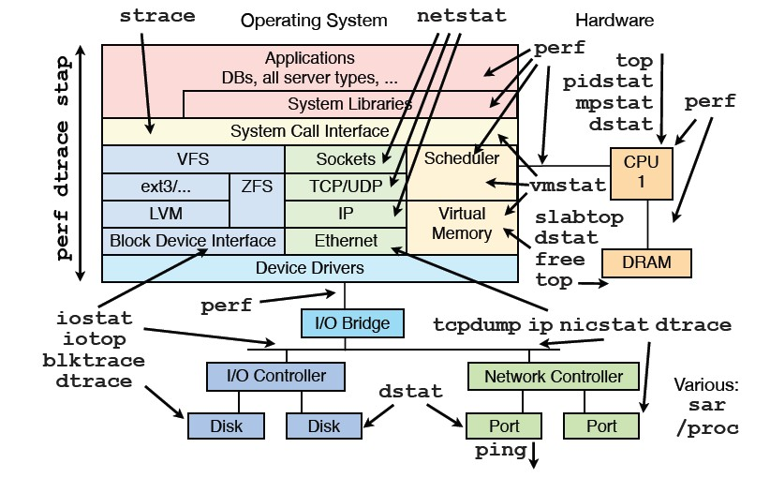
Linux常用性能调优工具索引

